Slide 1
Features
September 7, 2009

Slide 2
Building Activity
An Input-To Productivity

Slide 3
T Training
E Encourage
A Aim
M Motivation

Slide 4
Establish Objective Together
Focus on Contributions
Team Building
Develop a Participatory role
Promote Team responsibility

Slide 5
Key role in Team Building Activity
Motivation
Spirituality & Love
Open mindedness
Determination
Goal Orientation
Team Building

Slide 6
Work place with no "Goal-Orientation".

Slide 7
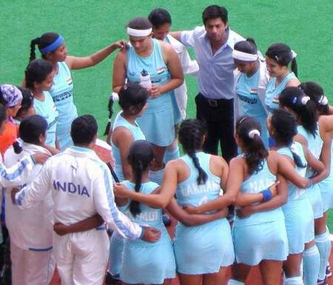
Never doubt that a small group of thoughtful
committed people can change the world. Indeed. It is the only thing that ever has

Slide 8
Importance of Team Building Activity
Leads one’s mind to creativity.
Encourage one to take initiative.
Combined effort to single target.
Provide space for individual growth.
Broaden one’s vision.
Rewards and recognition moves side by side.

Slide 9
Impact of Team Building Activity
Groom one’s personality.
Broaden the Vision.
Feeling of ‘WE’ flourish.
Developing trust we co-workers.
Sense of responsibility develop instead of blaming

Slide 10
Team Building activity-challenges ahead
Geographical Proximity.
Socio-cultural Diversity.
Economic background.

Slide 11
Unity is Strength

Slide 12
Talent wins games, but teamwork and intelligence wins championships

Slide 13
No matter what ever the geographical boundaries we have or whatever the ethic we possess and tradition we follow-we have to work together with a joined hands with mutual understanding to achieve a specific target-A ‘Goal’ ahead.
Over View

Slide 14
Thank you
Centum Learning Limited
Neelagagan, Mandi Road, Sultanpur, Mehrauli, New Delhi-110030
Tel: 91-11-46001100-01, Fax: 91-11-46001111
E-mail: contactus@bharti.in

