Slide 1
AN INTRODUCTION TO “INSULATION”

Slide 2
What is the insulation
Insulation is the process of keeping heat, sound, or electricity from spreading.
It's also the material used to do so.
If you can hear your neighbor snoring at night, you might need better sound insulation.
a material that reduces or prevents the transmission of heat or sound or electricity

Slide 3
INSULATOR
A material or an object that does not easily allow heat, electricity, light, or sound to pass through it.
Air, cloth and rubber are good electrical insulators; feathers and wool make good thermal insulators

Slide 4
THERMAL INSULATION
A thermal insulator is something that prevents heat from moving from one place to another.
There are 3 main ways that heat can travel: convection, conduction, and radiation.
Typically the phrase 'thermal insulator' refers to a material that blocks conduction.

Slide 5
Thermal conductivity K-VALUE
In simple terms this is a measure of the capacity of a material to conduct heat through its mass.
Different insulating materials and other types of material have specific thermal conductivity values that can be used to measure their insulating effectiveness. It can be defined as the amount of heat/energy (expressed in kcal, Btu or J) that can be conducted in unit time through unit area of unit thickness of material, when there is a unit temperature difference.
Thermal conductivity can be expressed in kcal m⁻¹ °C⁻¹, Btu ft⁻¹ °F⁻¹ and in the SI system in watt (W) m⁻¹ °C⁻¹. Thermal conductivity is also known as the k-value.

Slide 6
Coefficient of thermal conductance “ l” (kcal m⁻² h⁻¹ °C⁻¹)
This is designated as l (the Greek letter lambda) and defined as the amount of heat (in kcal) conducted in one hour through 1 m² of material, with a thickness of 1 m, when the temperature drop through the material under conditions of steady heat flow is 1 °C.
The thermal conductance is established by tests and is the basic rating for any material. l can also be expressed in Btu ft⁻² h⁻¹ °F⁻¹ (British thermal unit per square foot, hour, and degree Fahrenheit) or in SI units in W m⁻² Kelvin (K)⁻¹.

Slide 7
Thermal resistivity
The thermal resistivity is the reciprocal of the k-value (1/k).
Thermal resistance (R-value)
The thermal resistance (R-value) is the reciprocal of l (1/l) and is used for calculating the thermal resistance of any material or composite material.
The R-value can be defined in simple terms as the resistance that any specific material offers to the heat flow.
A good insulation material will have a high R-value. For thicknesses other than 1 m, the R-value increases in direct proportion to the increase in thickness of the insulation material. This is x/l, where x stands for the thickness of the material in metres.

Slide 8
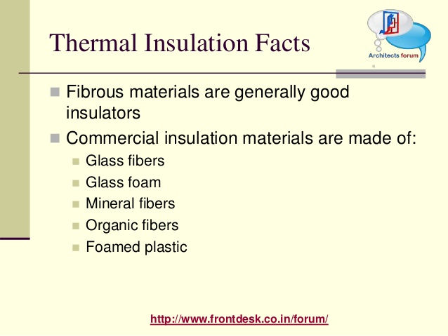

Slide 9
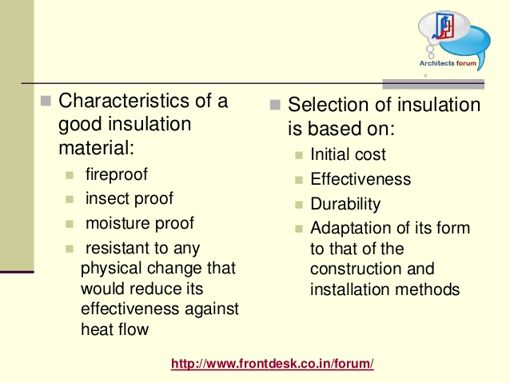

Slide 10
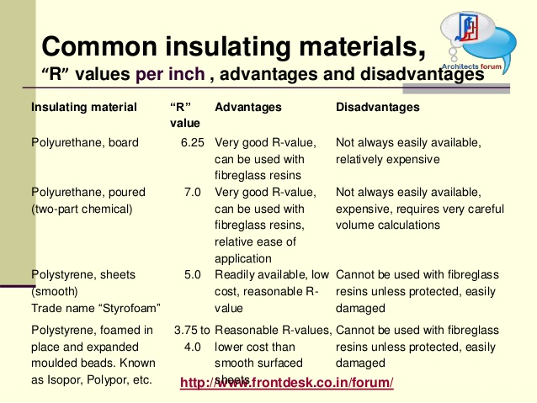

Slide 11
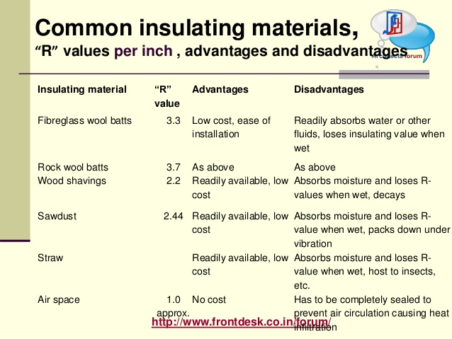

Slide 13
Economic Thickness of Insulation
The required thickness of insulation for any specific application depends upon the characteristics of the insulating material and the purpose of the equipment.
When the sole objective is to achieve the minimum total cost, the appropriate thickness is known as the economic thickness.

