Slide 1
Raw Mix Design, Burnability & Cement Quality

Slide 2
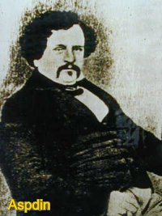
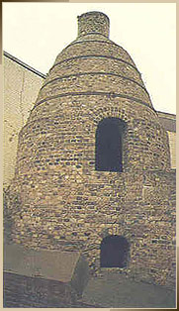
Cement is Very Old Material….
Basic Research and inventions Time Line
Research by Louis Vicat on Hydraulic Binders
Invention of Portland Cement by Joseph Aspedin
Invention of chemical Engineering process by Isaac Johnson
Cement Standard by Wilhelm Michaelis
1812
1824
1838
1875

Slide 3
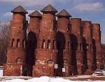
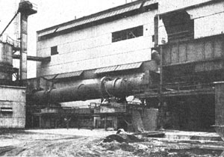
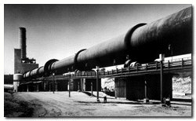
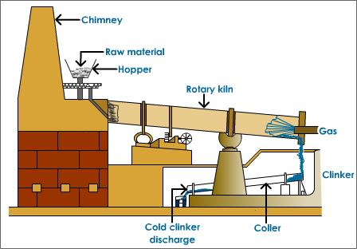
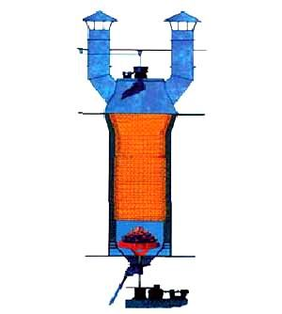
Cement Production Technologies
Control and instrumentation
Gears and bearings
Cooling and heat transfer
Material handling systems
Cyclone and filters
Long Rotary Kilns
Short Rotary Kilns and Preheater Technology
Vertical Kilns
Rotary Kilns
1830’s
1885
1930’s
1970’s
2000’s

Slide 4
PRINCIPLE OF RAW MIX DESIGN
1. Raw Material | : | Availability, chemical composition, amenability, impurities in industrial wastes, mineral composition
2. Physico-Mechanical properties | : | Crushability, grindability, plasticity, natural moisture content
3. Operation Efficiency | : | Pre-homogenization, grinding, blending, fineness, uniformity of chemical composition
4. Fuel | : | Mixture, ash content, volatile matter sulphur, calorific value
5. Standard specifications | : | IR, MgO, LOI, moduli values
6. Mineraliser and minor constituent | : | Source, effects, need, additives
Notes:
Raw mix affects the chemical reactions, fuel consumption, refractory lining, undesirable coating formation, quality of clinker and its production.

Slide 5
ASSUMPTIONS
The chemical reactions in the kiln proceeded to equilibrium.
Compounds are in pure form such as C₃S & C₂S
Presence of minor compounds are ignored.
Ferrite phase can be calculated as C₄AF
All oxides in the kiln have taken part in forming the compounds.

Slide 6
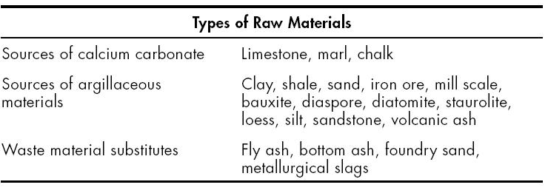
RAW MATERIALS
The fundamental chemical compounds to produce cement clinker are:
Lime (CaO)
Silica (SiO₂)
Alumina (Al₂O₃)
Iron Oxide (Fe₂O₃)
Raw materials used in the production of clinker cement
Notes:
The limestone (calcareous) and clays (argillaceous) are mostly used in cement preparation.
Sandstone (siliceous) bauxite (aluminous) and Iron ore, laterite (ferruginous) are used as corrective materials.
Raw material are characterized by
Chemical composition
Mineral composition
Physical composition
Mechanical characteristics

Slide 7
Common source of minerals
Calcium
Alkali waste
Iron
Blast-furnace flue dust
Silica
Anhydrite
Sulfate
Alumina
Aragonite
Calcite
Cement-kiln dust
Cement rock
Chalk
Clay
Fuller’s earth
Limestone
Marble
Marl
Seashells
Shale
Slag
Clay
Iron ore
Mill scale
Ore washings
Pyrite cinders
Shale
Calcium silicate
Cement rock
Clay
Fly ash
Fuller’s earth
Limestone
Loess
Marl
Ore washings
Quartzite
Rice-hull ash
Sand
Sandstone
Shale
Slag
Traprock
Aluminum-ore refuse
Bauxite
Cement rock
Clay
Copper slag
Fly ash
Fuller’s earth
Granodiorite
Limestone
Loess
Ore washings
Shale
Slag
Staurolite
Calcium sulfate
Gypsum

Slide 8
CaO Reactivity
Ankerite
Dolomite
Calcite
The dissociation of Calcium Carbonate in the rock depends on
there textural and microstructure features.
Highly crystalline limestone dissociates at higher temperature
than amorphous variety.
The rate of dissociation and reaction temperature are directly
related to the grain size.

Slide 9
Muscovite
Kaolinite
Illite
Montmorillonite
Chlorite
Reactivity of Clay with CaCO₃
Clay are essentially hydrous alumino-silicates constituting the
combined source of SiO₂ and Al₂O₃.
Clay are extremely variable in composition and thermal behaviour.
Clay under go dehydration, dehydroxilation breakdown of crystal
structure releasing Al₂O₃ and SiO₂ in reactive form.
Notes:
Clay with more than 3 % R₂O and 1 % SO₃ consider as undesirable.

Slide 10
Quartz
Silica of Feldspar
Silica of Mica
Tridymite
Chalcedony
Opal
Cristobalite
Silica from Slag
Reactivity of Silica with CaO
The mineralogical nature and characteristic of silica have a
strong influence on the reactivity of cement raw mix.
Silicates reacts more readily than free silica or uncombined
silica such as quartz, flint, chert.

Slide 11
HOMOGENISATION
The limestone quality varies from one bench to another bench in the same
quarry.
The quality variations are large when limestone received from two or
more different sources.
Such limestone cannot be fed into the system and requires pre-blending to
minimise these variations of the incoming limestone quality.
The quality variations are minimised by stacking and reclaiming system.
Pre-blending is mostly applied for main component of raw material
namely limestone.
The argillaceous component is predominately pre-homogenised.
Notes:
The crushing index and grindability of limestone, clay, laterite, bauxite depends upon the mineral composition and grain size of primary constituent minerals.
The most significant physico-mechanical properties of raw material are crushability, grindability, natural moisture content, plasticity, fineness and homogeneity.

Slide 13
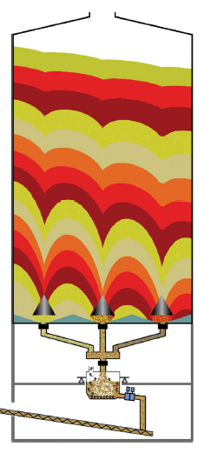
Notes:
The components existing in dispersed form are subjected to semi fusion state resulting in a series of physico chemical reactions,
yield clinker, i.e. a synthetic mixture of calcium silicate, calcium aluminate and calcium alumino ferrite phases in solid state.

Slide 14
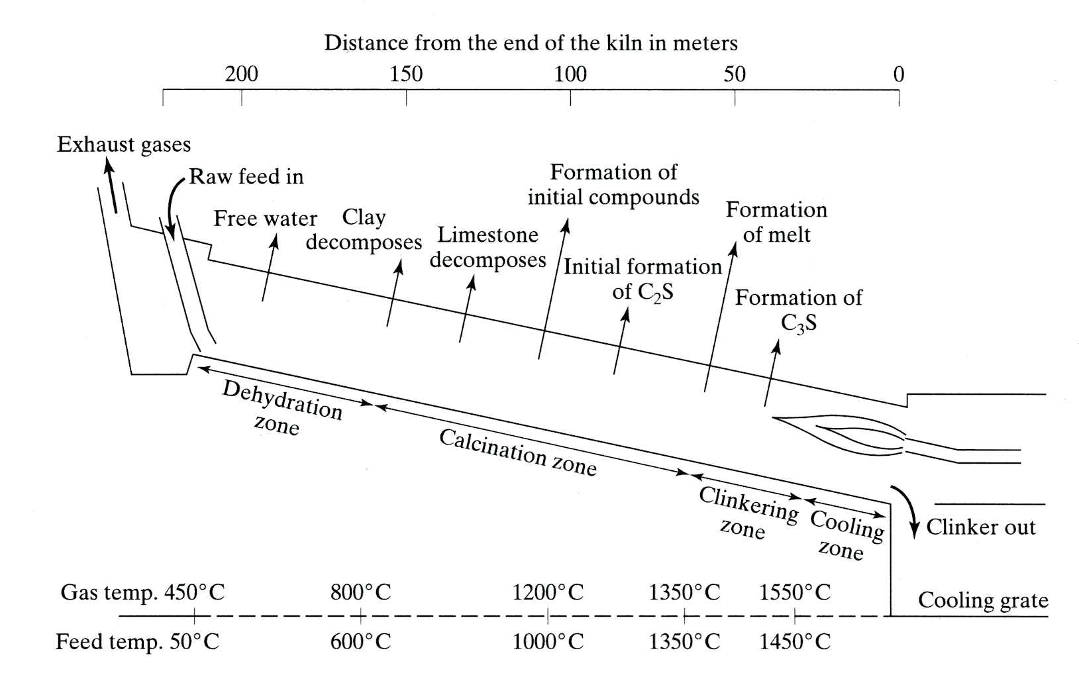

Slide 15
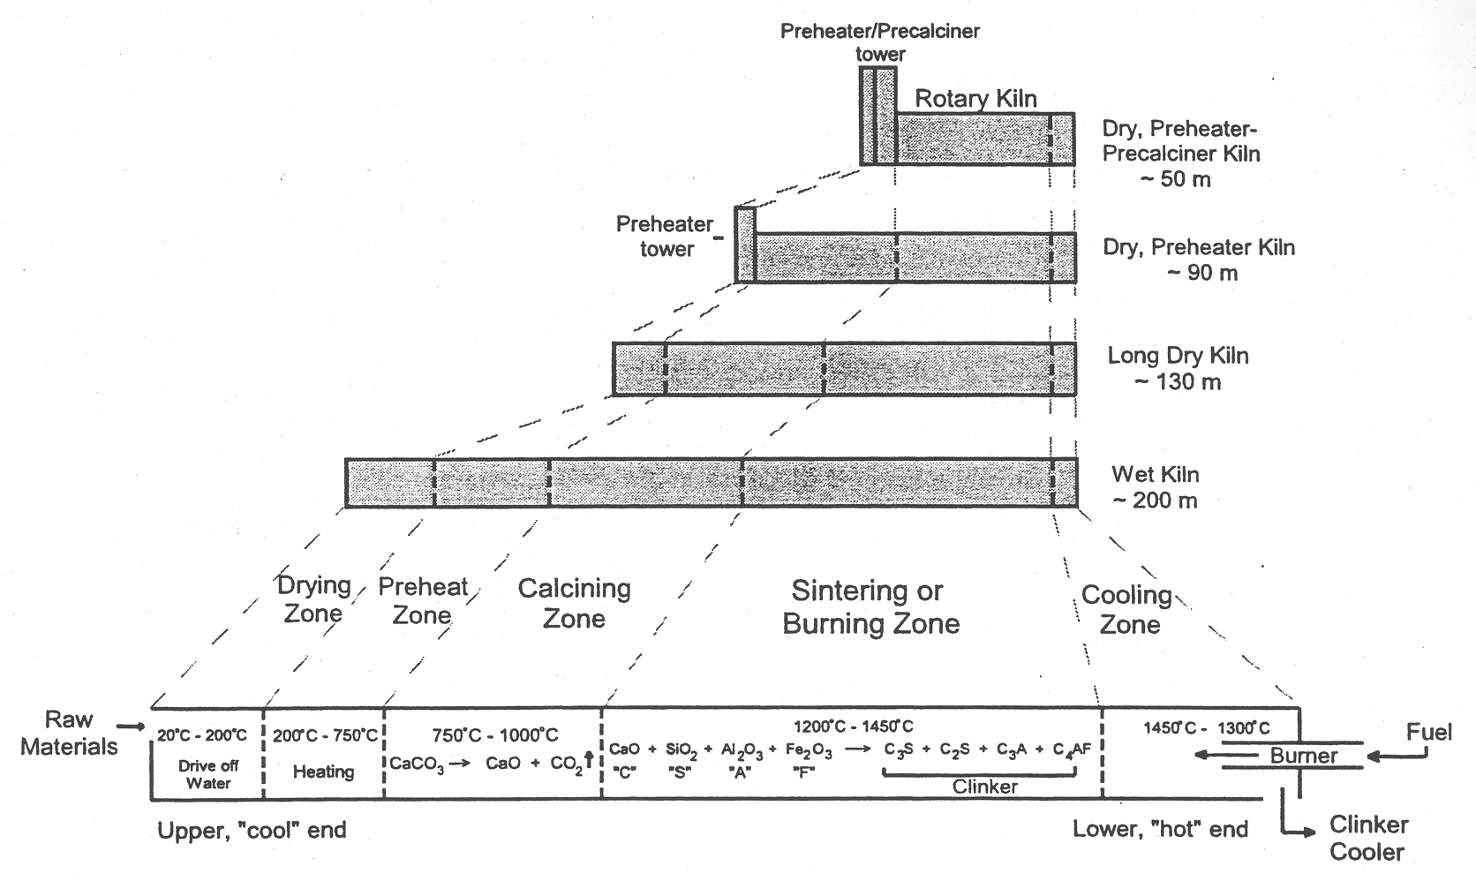

Slide 16
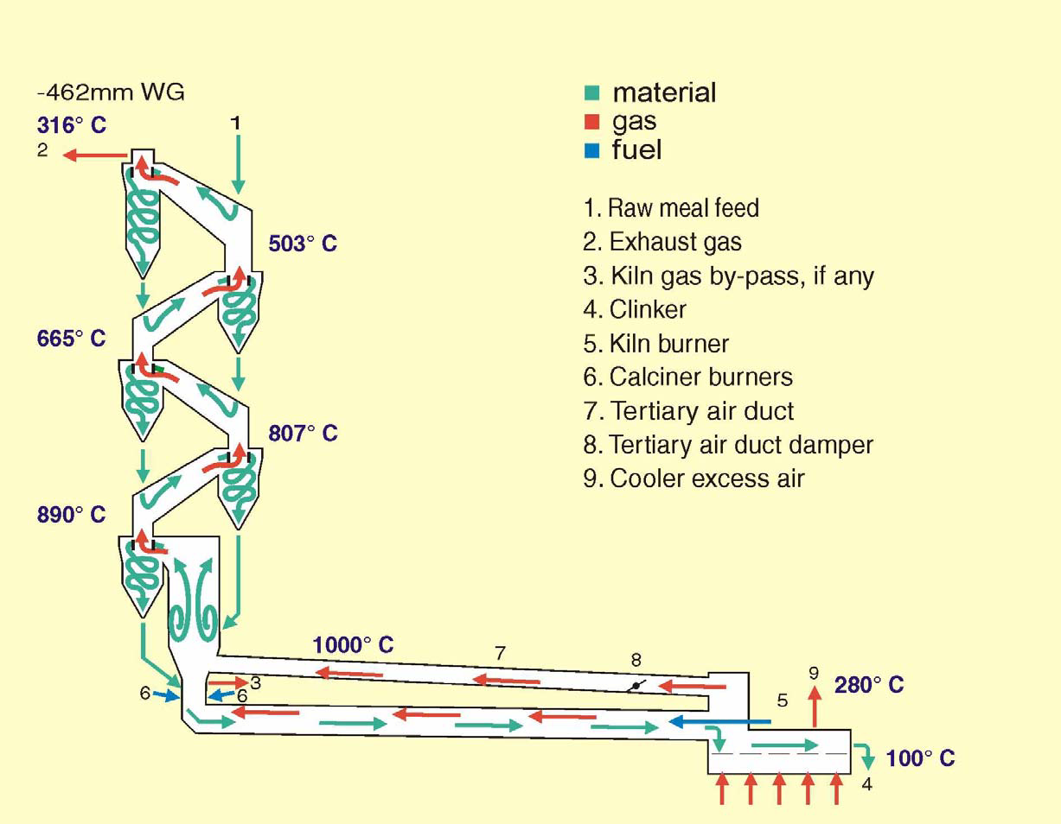
Pyro-processing System
Preheater
Rotary Kiln
Cooler

Slide 17
Preheater
What is happning at the Preheater?
Raw material separation and suspension for heat absorption.
Moisture Removal
Decomposition of CaCO3, MgCO3, formation of CA,
C2F and C3S begins.
Formation of C12A7

Slide 20
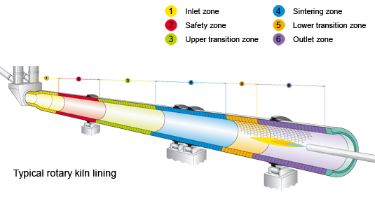
Rotary Kiln
Formation of C3A and C4AF begins, decomposition of
CaCO3 completed, free lime reaches maximum
Formation of C2S reaches maximum,
C3A and C4AF formation completed
Formation of liquid phase
Formation of C3S, gradual decrease of free lime content.

Slide 26
METHODS FOR CALCULATION
Several Methods are available for the calculation of Raw mix for two & more component systems. The common methods are as follows :
1. Allegation Alternate Method
This method is used for solving the blending equations of two components only.
2. Matrix and Determinant Method
This method is used for calculating two and more than Two Component System of Raw mix designing.

Slide 27
1. Allegation Alternate Method
This is the simplest method for solving blending problems. The method allows the determination of the proportion of two Raw material components with required set point. The working is explained by an example, as under : What mixing proportion is required for Limestone with 78.1% T.C. and Silica sand with 1.5% T.C. to get a raw mix of 77% T.C. :
T.C. of Lime stone 78.1
75.5 Parts of Limestone
77
T.C. of Silica sand 1.5
1.1 Parts of Silica sand
Converting the parts proportion to weight percentage
75.5 x 100
% Limestone = = 98.56%
75.5 + 1.1
1.1 x 100
% Silica sand = = 1.44%
75.5 + 1.1

Slide 28
CALCULATION OF CLINKER COMPOSITION
FROM THE COMPOSITION OF RAW MIX
It is necessary to understand the conversion of analytical data of raw mix to composition of clinker. This is done in the following way :
1. Conversion of analytical data of Raw mix to ignited basis :
Conversion factor = 1 - (% LOI of Raw mix /100)
% Constituent (Raw mix)
% Constituent (Ignited) =
Conversion factor
All the constituents of raw mix are calculated on ignited basis and a Loss free Kiln feed (LFKF) is obtained..

Slide 29
2. Matrices and Determinant Method
This method is slightly complicated but it provides us more facilities to calculate the ratio of raw components. With the use of this method we can calculate two or more than two component system of raw mix designing with variable set points. The set points can be aimed both at the Raw mix as well at the clinker.
The methods for calculation are as follows :
A. Calculation of Matrix elements
In raw mix design calculation, each element of matrices is made from two parts. First is alphabet and second is a number. The alphabet part indicates the raw component and the number indicates corresponding set point. Therefore, a metrics element is like A1, A2, B1, B2…E4 etc.

Slide 30
These elements are calculated in following manner :
a. If set point is LSF
Calculation for raw component proportioning 1
Element = CaO - (Set point x (2.8 SiO₂ + 1.2 Al₂O₃ + 0.65 Fe₂O₃))
Calculation for raw component with unknown proportion
Element = (Set point x (2.8 SiO₂ + 1.2 Al₂O₃ + 0.65 Fe₂O₃)) - CaO
b. If set point is SM
Calculation for raw component proportioning 1
Element = SiO₂ - (Set point x (Al₂O₃ + Fe₂O₃))
Calculation for raw component with unknown proportion
Element = (Set point x (Al₂O₃ + Fe₂O₃)) - SiO₂

Slide 31
c. If set point is AM
Calculation for raw component proportioning 1
Element = Al₂O₃ - (Set point x Fe₂O₃)
Calculation for raw component with unknown proportion
Element = (Set point x Fe₂O₃) - Al₂O₃
d. If set point is HM
Calculation for raw component proportioning 1
Element = CaO - (Set point x (Fe₂O₃ + Al₂O₃ + SiO₂))
Calculation for raw component with unknown proportion
Element = (Set point x (Fe₂O₃ + Al₂O₃ + SiO₂)) - CaO

Slide 32
e. If set point is CaO
Calculation for raw component proportioning 1
Element = CaO - Set point
Calculation for raw component with unknown proportion
Element = Set point - CaO
f. If set point is SiO₂
Calculation for raw component proportioning 1
Element = SiO₂ - Set point
Calculation for raw component with unknown proportion
Element = Set point - SiO₂

Slide 33
g. If set point is Al₂O₃
Calculation for raw component proportioning 1
Element = Al₂O₃ - Set point
Calculation for raw component with unknown proportion
Element = Set point - Al₂O₃
h. If set point is Fe₂O₃
Calculation for raw component proportioning 1
Element = Fe₂O₃ - Set point
Calculation for raw component with unknown proportion
Element = Set point - Fe₂O₃

Slide 34
CALCULATIONS FOR TWO COMPONENT SYSTEM
The two component system allows only one set point. Therefore, we have only two matrix elements which are A1 and B1. The calculation of A1 and B1 is described previously.
In this method, it is assumed that X parts of the first component are proportioned to 1 part of second component, hence
X = A1 / B1
The percent proportion of both components are calculated as follows :
X
% Component 1 = ( ) x 100
X + 1
1
% Component 2 = ( ) x 100
X + 1

Slide 35
CALCULATIONS FOR THREE COMPONENT SYSTEM
The three component system allows two set points. Therefore, we have six matrix elements which are A1, B1, & C1 for first set point and A2, B2 & C2 for second set point. The calculation of these elements is described previously. Here also the materials are apportioned as the ratio of X : Y : 1 for first, second and the third component respectively. Therefore, the following three matrices are obtained :
A1 A2
B1 B2
C1 C2
B1 B2
A1 A2
C1 C2
Md =
Mx =
My =

Slide 36
These determinants are solved in the following manner :
Md = A1 B2 - B1 A2
Mx = C1 B2 - B1 C2
My = A1 C2 - C1 A2
The proportions are calculated as :
X = Mx/Md
Y = My/Md
The percent proportion of all the three components are calculated as follows :
% of First component = (X/(X+Y+1)) x 100
% of Second Component = (Y/(X+Y+1)) x 100
% of Third Component = (1/(X+Y+1)) x 100

Slide 37
CALCULATIONS FOR FOUR COMPONENT SYSTEM
In a four component system, it is possible to calculate proportions with three set points. Therefore, we have twelve matrix elements which are A1, B1, C1 & D1 for first set point A2, B2 C2 & D2 for second set point and A3, B3, C3 & D3 for third set point. The calculation of these elements is described previously.
Assuming that X, Y, Z and 1 parts of the four components respectively are mixed together to arrive at the desired composition. The following three equations are obtained :
A1.X + B1.Y + C1.Z = D1
A2.X + B2.Y + C2.Z = D2
A3.X + B3.Y + C3.Z = D3

Slide 38
From the above equations we get following four matrices
A1 A2 A3
B1 B2 B3
C1 C2 C3
D1 D2 D3
B1 B2 B3
C1 C2 C3
Md =
Mx =
A1 A2 A3
D1 D2 D3
C1 C2 C3
A1 A2 A3
B1 B2 B3
D1 D2 D3
My =
Mz =

Slide 39
These determinants are solved in the following manner :
Md = A1(B2.C3 - B3.C2) - A2(B1.C3 - B3.C1) + A3(B1.C2 - B2.C1)
Mx = D1(B2.C3 - B3.C2) - D2(B1.C3 - B3.C1) + D3(B1.C2 - B2.C1)
My = A1(D2.C3 - D3.C2) - A2(D1.C3 - D3.C1) + A3(D1.C2 - D2.C1)
Mz = A1(B2.D3 - B3.D2) - A2(B1.D3 - B3.D1) + A3(B1.D2 - B2.D1)
The proportions are calculated as :
X = Mx/Md
Y = My/Md
Z = Mz/Md

Slide 40
The percent proportion of all the four components are calculated as follows :
% of First component = (X/(X+Y+Z+1)) x 100
% of Second Component = (Y/(X+Y+Z+1)) x 100
% of Third Component = (Z/(X+Y+Z+1)) x 100
% of Fourth Component = (1/(X+Y+Z+1)) x 100
After calculating the proportion of raw component, the composition of clinker can be calculated.

Slide 42
TWO COMPONENT SYSTEM
The mixing proportion is required for limestone with 86.3% CaCO3 and clay with 28% CaCO3 to get a raw mix with a CaCO3 content of 74.3%
Limestone Parts Limestone
86.3 46.3
74.3
Clay Parts Clay
28 12

Slide 43
COAL ASH ABSORPTION
Coal Consumption % | = | Sp. Heat Cons. X 100 UHV
Specific Heat Cons. (Kcal/Kg fuel) | = | UHV x Coal Cons. 100
Ash Absorption % | = | Ash (%) x Coal Cons. 100

Slide 44
MINERAL PHASES OF PORTLAND
CEMENT CLINKER
Mineral Phases | Formulae | Abbreviation
1. Tricalcium Silicate (Alite) | 3CaO.SiO₂ | C₃S
2. Dicalcium Silicate (Belite) | 2CaOSiO₂ | C₂S
3. Tricalcium Aluminate | 3CaOAl₂O₃ | C₃A
4. Tetra calcium alumino ferrite AL2O3 > Fe2O3 | 4CaOAl₂O₃Fe₂O₃ | C₄AF
5. Calcium alumino ferrite Al₂O₃ > F₂O₃ | 2CaO(Al₂O₃Fe₂O₃) | C₂AF
6. Free CaO | CaO
7. Free Magnesium oxide | MgO
8. Alkali containing aluminate K₂O + Na₂O > SO₃ | (K,Na)₂O,8CaO, 3Na₂OK₁,N)CA₃
9. Alkali sulphate K₂O + Na₂O > SO₃ | (K,Na)₂SO₄ , CaSO₄
10. Calcium sulphate K₂O + Na₂O > SO₃ | (K,Na)₂SO₄ , CaSO₄

Slide 45
ROLE OF MODULI VALUES

Slide 46
Parameter | Limiting Values | Effects
Lime Saturation Factor | 0.66–1.02 (0.88-0.92) | A high LSF Makes it difficult to burn raw mix. Tends to produce unsound cement (High CaO) Increases C3S contents Reduces C2S content Cause slow setting with high early strength.

Slide 47
Parameter | Limiting Values | Effects
Silica Modulus SM | 1.9 – 3.2 (2.2 – 2.6) | A High SM Results in harder burning and high fuel consumption. Causes difficulty in coating formation and hence the radiation losses from shell are high. Deteriorates the kiln lining Results in slow setting and hardening cement.

Slide 48
Parameter | Limiting Values | Effects
Alumina Modulus AM | 1.5 – 2.5 (1.3 -1.6) | A higher AM Imparts harder burning and entails higher fuel consumption. Increases the proportion of C3A and reduce C4AF. Reduce the liquid phase and kiln output. Tends to render quick setting and strength at early ages.

Slide 49
Influence of Compound Composition on Characteristics of P.C.
P.C.+water→the compounds in the cement undergo chemical reactions with the water independently, and different products result from these reactions.
 | C₃S | C₂S | C₃A | C₄AF
Rate of Reaction | Moderate | Slow | Fast | Moderate
Heat Liberation | High | Low | Very High | Moderate
Early Cementitious Value | Good | Poor | Good | Poor
Ultimate Cementitious Value | Good | Good | Poor | Poor

Slide 50
POTENTIAL CLINKER COMPOSITION
C3S | = | 4.071CaO – 7.6SiO2 – 6.718 Al2O3 – 1.43 Fe2O3
C2S | = | 2.867 SiO2 – 0.7544 C3S
C3A | = | 2.65 Al2O3 – 1.692 Fe2O3
C4AF | = | 3.043 Fe2O3 (If AM > 0.64)
LSF | = | CaO/(2.8SiO2 + 1.65 Al2O3 + 0.65Fe2O3)
SM | = | SiO2 / (Al2O3 + Fe2O3)
AM | = | Al2O3 / Fe2O3
HM | = | CaO/(SiO2 + Al2O3 + Fe2O3)

Slide 51
FORMULA USED AT BEAWAR & RAS
Moduli/Phase | Formula Used For Clinker
LSF | LSF = If (SO3-.0.85K2O-1.29 Na2O)<0, CaOx100/(2.8SiO2 + 1.18 Al2O3 + 0.65 Fe2O3 )
LSF | LSF = If (SO3-.0.85K2O-1.29 Na2O)>0, 100(% CaO-0.7x(SO3-.0.85K2O-1.29 Na2O)/(2.8SiO2 + 1.18 Al2O3 + 0.65 Fe2O3 )
SM | SM = SiO2 / (Al2O3 + Fe2O3)
AM | AM = Al2O3 / Fe2O3
C3S | C3S = If (SO3-1.29Na2O-0.85K2O)<0, 4.071 ( CaO-FCaO )-( 7.602 SiO2+ 6.719 Al2O3 + 1.43 Fe2O3 )
C3S | C3S = If (SO3-1.29Na2O-0.85K2O)>0, 4.071 ( CaO-FCaO-0.7(SO3-1.29Na2O-0.85K2O) )-( 7.602 SiO2+ 6.719 Al2O3 + 1.43 Fe2O3 )
C2S | 2.867 SiO2 -0.754 C3S
C3A | 2.65 x Al₂O₃ - 1.69 x Fe₂O₃
C4AF | 3.04 x Fe2O3
Liquid Phase | 1.35 C4AF + 1.13 C3A + MgO + Na2O + K2O
Sulphur/ Alkali ratio | SO3/(1.29Na2O+.85K2O)
HM | CaO/(SiO2+Al2O3+Fe2O3)
CS | CaO/SiO2
BT | 1300+4.51C3S-3.74C3A-12.64C4AF
Formula Used For Raw Meal
LSF = 100(% CaO/(2.8SiO2 + 1.18 Al2O3 + 0.65 Fe2O3 )
SM = SiO2 / (Al2O3 + Fe2O3)
AM = Al2O3 / Fe2O3

Slide 52
C₂S & C₃S: 70-80% of cement is composed of these two compounds & most of the strength giving properties of cement is controlled by these compounds.
Upon hydration both calcium-silicates result in the same products.
2C₃S+6H → C₃S₂H₃ + 3CH
2C₂S+4H → C₃S₂H₃ + CH
Calcium-Silicate-Hydrate (C-S-H gel) is similar to a mineral called “TOBERMORITE”. As a result it is named as “TOBERMORITE GEL”

Slide 53
Upon hydration C₃S & C₂S, CH also forms which becomes an integral part of hydration products. CH does not contribute very much to the strength of portland cement.
C₃S having a faster rate of reaction accompanied by greater heat generation developes early strength of the paste. On the other hand, C₂S hydrates & hardens slowly so results in less heat generation & developes most of the ultimate strength.

Slide 54
Higher C₃S→higher early strength-higher heat generation (roads, cold environments)
Higher C₂S→lower early strength-lower heat generation (dams)
C₃A: is characteristically fast reacting with water & may lead to a rapid stiffening of the paste with a large amount of the heat generation (Flash-Set)-(Quick-Set). In order to prevent this rapid reaction gypsum is added to the clinker. Gypsum, C₃A&water react to form relatively insoluble Calcium-Sulfo-Aluminates.

Slide 55
C₃A+CŚH₂+10H→C₄AŚH₁₂ (calcium- alumino-monosulfohydrate)
C₃A+3CŚH₂+26H→C₆AŚ₃H₃₂ (calcium-alumino-trisulfohydrate “ettringite”)
When there is enough gypsum “ettringite” forms with great expansion
If there is no gypsum→flash-set
more gypsum→ettringite formation increases
which will cause cracking

Slide 56
Also Calcium-Sulfo Aluminates are prone (less resistant) to sulfate attack & does not contribute much for strength. The cement to be used in making concretes that are going to be exposed to soils or waters that contain sulfates should not contain more than 5% C₃A.
C₄AF: The hydration of ferrite phase is not well understand. Ferrite phase has lesser role in development of strength. The hydration products are similar to C₃A. Alumina & iron oxide occur interchangebly in the hydration products.
C₄AŚH₁₂ or C₄FŚH₁₂
C₆AŚ₃H₃₂ or C₆FŚ₃H₃₂

Slide 57
Portland Cement → Gypsum+Portland Cement Clinker (pulverizing)
Portland Cement Clinker → Calcareous & Clayey Materials (burning)
Paste → P.C. + Water
Mortar → P.C. + Water + Sand
Concrete → P.C. + Water + Sand + Gravel

Slide 58
DETERMINATION OF BURNABILITY INDEX
 | Prepare raw mix pallets of about 1-2 cm dia using 5-6% water.
 | Dry them in an oven at a temperature 150°C till dryness.
 | Introduce the pallets in the furnace and raise the temperature to 1000°C
 | First sample removed after 20 minutes of soaking.
 | The temperature is raised to 1100 °C and sample is drawn after 20 minutes of soaking
 | Repeat this procedure at 1200, 1300, 1350 & 1400 °C to obtain 7 samples.
 | The Free Lime of these samples are determined in sequence from C₀ to C₆.
BI = | 600
 | C₀+2C₁+2C₂+3C₃+4C₄+4C₅+2C₆

Slide 60
BURNABILITY INDEX
The burnability index is defined as
BI = C3S/(C3A + C4AF)
A high value of BI denotes poor burnability.
Modified formula for BI
BI = C3S / (C3A + C4AF + MgO + Alkalies)
PERAY & WADDELL’S BURNABILITY FACTOR
BF = LSF + 10 SM – 3 (MgO + Alkalies)

Slide 61
Particle size and burnability
Bigger particle size affect the burnability of raw mix.
+ 125 µ for calcite
+ 63 µ for feldspar
+ 50 µ for shale
+ 45 µ for quartz
+ 125 µ for dolomite

Slide 62
Thank you

