Slide 1
Crossflow Membrane Types
Microfiltration
Ultrafiltration
Nanofiltration
Reverse Osmosis
Notes:
1

Slide 2
Filtration Spectrum
1
2
3
5
8
100
1000
10₄
10₅
10₆
10₇
10
Angstrom
Pollens
Sugars
Viruses
Beach Sand
Aqueous
Bacteria
Salts
Colloids
Particle Filtration
Particle Filtration
Microfiltration
Microfiltration
Ultrafiltration
Ultrafiltration
Nano-
Nano-
filtration
filtration
Reverse
Reverse
Osmosis
Osmosis
Notes:
2

Slide 3
Terms & Formulas
FLUX RATE
A customer wishes to produce 100,000 gallons/day at a flux of 15 gallons/ft²/day
F=Q/A
A=Q/F
A=100,000 gpd/15 gfd
A=6,667 square feet
Since there are 365 square feet in a CPA2 8” x 40” membrane:
Number of membranes= 6667sq. ft.
365 sq. ft.
= 19 membranes
Notes:
3

Slide 4
Industrial Design Guidelines
Seawater 8-12 gfd
Brackish surface water 10-14 gfd
Brackish well water 14-18 gfd
RO/UF permeate 20-30 gfd
Notes:
4

Slide 5
Three Element Pressure Vessel
Permeate
port
Brine seal
Interconnector
End plate
Concen-
trate port
Membrane
Membrane
Membrane
element
element
element
Feed port
Pressure vessel
Notes:
5

Slide 6
Composite Polyamide Membrane
Advantage: 60 to 80% reduction in energy
Advantage: Lower salt passage
Advantage: Wider pH range
Con: Negative surface charge
Con: Limited chlorine resistance
Notes:
6

Slide 7
RO Membrane Diagram
Permeate Tube
“O” Ring
Mesh Spacer
Outer Cover
Permeate Carrier
Membrane

Slide 8
Low Fouling Composite Membrane
Advantage: 60 to 80% reduction in energy as compared to cellulose acetate
Advantage: Lower salt passage than cellulose acetate
Advantage: Wider pH range than cellulose acetate
Advantage: Neutral surface charge
•Con: Limited chlorine resistance similar to composite polyamides
Notes:
8

Slide 9
Spiral Wound RO Membrane Comparison
Notes:
9

Slide 10
RO Element Construction
Higher membrane area can mean lower fluxes and higher cross-flow velocities
Feed/Brine spacer thickness' of 26 to 34 mils have proven suitable for use on surface water sources
Manufacturing quality standard is important (glue seal integrity, FRP over-wrap, no wrinkles, etc.)
Notes:
10

Slide 11
Membrane Prepping
Notes:
11

Slide 12
Notes:
12

Slide 13
Element Rolling
Notes:
13

Slide 14
Element Rolling
Notes:
14

Slide 15
Element Trimming
Notes:
15

Slide 16
Brine Seal Carrier Attachment
Notes:
16

Slide 17
Fiberglass Outer-wrap
Roving strand
Notes:
17

Slide 19
Element Inspection
Notes:
19

Slide 20
Feed Channel Blockage
Spacer thickness vs. particle size
Turbulence and pressure drop
Particulate blockage and biofouling
Symptoms
Prevention
Notes:
20

Slide 21
Membrane Foulants
Scale (e.g. calcium carbonate)
Bacteria and bacterial slime
Organic debris (e.g. algae)
Colloids (e.g. clays and colloidal silica)
Metal Hydroxides
Chemical precipitates
Notes:
21

Slide 22
Identifying Fouling Conditions
Analysis of feed, concentrate, permeate
Normalization of system performance
Probing of individual vessels
Visual inspection of system and elements
Analysis of the cleaning solution
Element testing and autopsy
Analysis of fouling deposits
Operation of a membrane sampling device
Notes:
22

Slide 23
Categories of Membrane Fouling
Blockage of the feed channel
Surface absorption of organics
Membrane scaling
Membrane barrier deterioration
Notes:
23

Slide 24
Membrane Scaling
Saturation limits
Scale formation process
Scale inhibitors
Symptoms
Prevention
Notes:
24

Slide 25
Membrane Element Design Limits
Saturation Limits for Sparingly Soluble Salts in the Concentrate:
Salt Saturation %
CaSO4 230
SrSO4 800
BaSO4 6000
SiO2 100 (or < 160 PPM)
Limits of Saturation Indices:
Condition* LSI Value
LSI and SDSI without scale inhibitor < -0.2
LSI & SDSI with SHMP < 0.5
LSI & SDSI with organic scale inhibitor < 1.8
*Langelier and Stiff & Davis Saturation Indices
Notes:
25

Slide 26
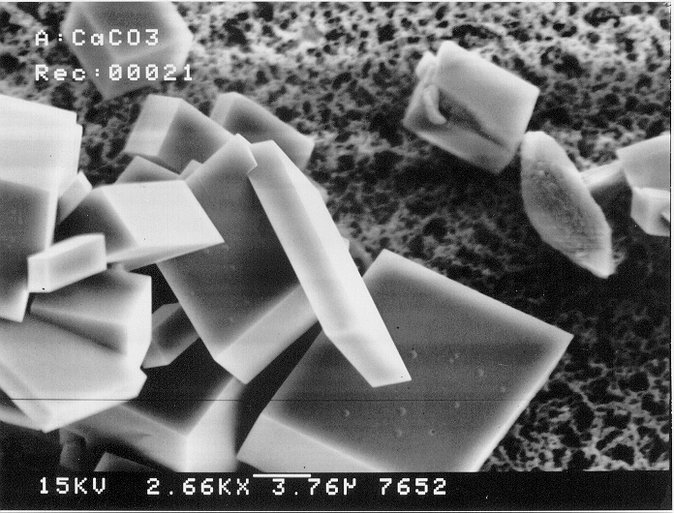
Calcium carbonate crystals
Notes:
26

Slide 27
Notes:
27

Slide 28
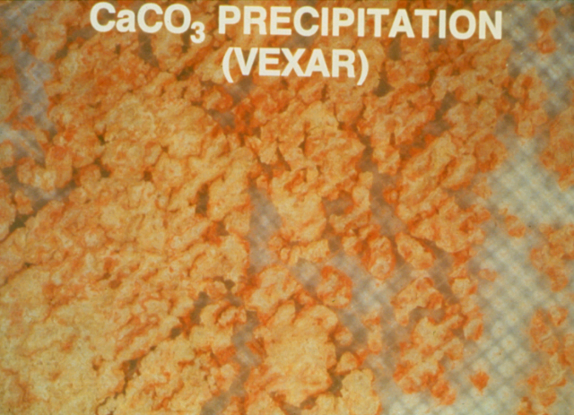
CALCIUM CARBONATE SCALING
Notes:
28

Slide 29
Proper Pretreatment Protects Against...
Scale Formation
Colloidal Fouling
Biological Fouling
Chemical Fouling
Notes:
29

Slide 30
Protecting Against Scale
Complete Water Analysis
Perform Scaling Calculations
Choose Pretreatment
Notes:
30

Slide 31
Components for a
Complete Water Analysis
Calcium
Magnesium
Sodium
Potassium
Barium
Strontium
Iron
Silica
Aluminum
Sulfate
Bicarbonate
Chloride
Nitrate
Phosphate
Fluoride
pH
Notes:
31

Slide 32
Chemical Deterioration of the Membrane Barrier
Polyamide structure
Exposure to chlorine and chloramines
Other oxidants
Symptoms
Prevention
Notes:
32

Slide 33
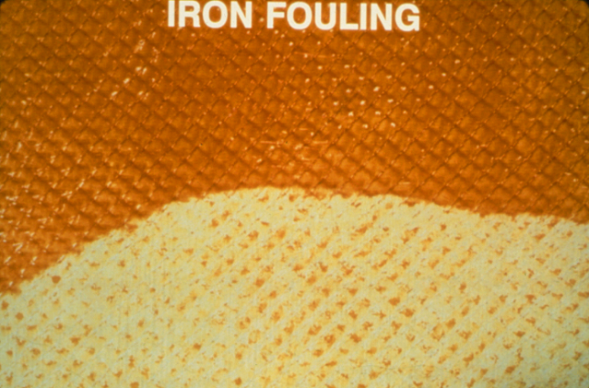
IRON FOULING
Notes:
33

Slide 34
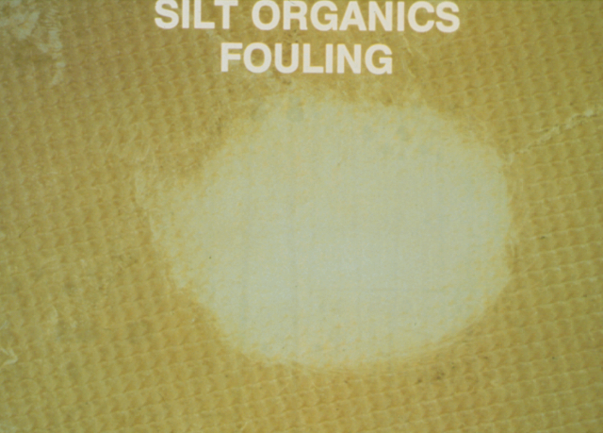
SILT FOULING
Notes:
34

Slide 35
CONTROLLING BIOLOGICAL FOULING
Clean Pretreatment Equipment and Piping
Clean & Sanitize RO
Biogrowth Control Program
(Non-oxidizing biocides)
Notes:
35

Slide 36
BIOLOGICAL FOULING
Causes:
  Improper carbon bed maintenance
  High biological count in the feed water
  System sitting idle without adequate preservation
Symptoms:
  _{High system delta P}
  _{Reduced permeate flows}
  Maintained or increased salt rejection
  _{Odor or visible slime growth}
Solutions:
Disinfect system with non-oxidizing biocide; follow with
high pH clean.
Notes:
36

Slide 37
SILT FOULING
Notes:
37

Slide 38
SILT FOULING
Causes:
  Surface waters with high colloidal content
  _{Inadequate pretreatment}
  _{Filter breakthrough}
  Advanced biological fouling retaining colloidal particles
Symptoms:
  Reduction in permeate flow rate
  _{Reduction in salt rejection}
  Increase in first stage delta P
  _{Visible element discoloration}
Solution:
Clean system with high pH
Notes:
38

Slide 39
Element Examination Procedure
Weigh element
Integrity testing (vacuum, pressure, dye passage)
Performance testing at nominal test conditions
Notes:
39

Slide 40
Membrane Element Examination
Glue line integrity
Surface defects
Surface patterns
Flat cell testing of membrane performance
Notes:
40

Slide 41
RO Troubleshooting and Normalization
Life is like a box of chocolates. You never know what you are going to get!
  Forrest Gump

Slide 42
RO Troubleshooting
Identifying a Problem
Did you have a RO system upset?
Did you shutdown the RO system properly or for too long.
Did you have a RO Pretreatment or Chemical Feed upset?
Verify for proper Feed Temperature, TDS, and pH.
Verify for proper flowrates and % Recovery.
Verify Pressure Drop (feed to reject) is OK.
Verify all instruments are calibrated properly.
Normalize Permeate Flow and Permeate Quality.
Measure Permeate Quality by stage and by pressure vessel.
Probe individual vessels for mechanical seal failures.
Inspect RO Feed Cartridge Filter for foulants.
Inspect RO Elements for foulants or damage.

Slide 43
RO Troubleshooting
Identifying a Problem
Sample and obtain a detailed Water Analysis of the RO Feed, Concentrate and the Permeate by stage and combined.
Compare the results of the Water Analyses to RO Design Projections.
Determine suspected foulant based on changes in Normalized Permeate, Flow, Normalized Permeate Quality and Pressure Drop.
Perform a Cleanup based on the expected foulant or scalant.
Analyze the Cleanup Solution for foulants removed, color change or pH change.
Send RO element out for Non-Destructive Autopsy and determination of Cleanup Protocol.
Finally, have Destructive Autopsy and lab analysis of foulants.

Slide 44
Common RO Fouling Processes
Membrane Degradation
  Hydrolysis (caused by low or high pH)
  Oxidation (Cl₂, H₂O₂, KMnO₄)
  Mechanical Damage (Permeate Back Pressure, Telescoping, Thermal, Abrasion by Carbon Fines or Silt)
Precipitation Deposits
  Carbonate Scale (Ca)
  Sulfate Scale (Ca, Ba, Sr)
  Silica Scale (SiO₂)
Colloidal Deposition
  Metal Oxides (Fe, Zn, Al, Cr)
  Silt

Slide 45
Common RO Fouling Processes
Organic Deposition
  Naturally Occurring (Humic and Fulvic)
  Insoluble Oil (Leaking pump seals, new pipe)
  Antiscalant overfeed or precipitation by iron
  Cationic Polymer overfeed (from upstream filters)
Biological Growth
  Bacterial Sliming of CPA membranes
  Bacterial attack to CAB membranes
  Algae
  Fungi

Slide 46
Symptoms of RO Fouling
Pressure Drop increase
Change in RO Feed Pressure
Change in Normalized Permeate Flow
Change in Normalized Salt Passage

Slide 47
RO Troubleshooting Matrix

Slide 48
RO Troubleshooting Matrix

Slide 49
How to Avoid Cleanups
Design the RO system with a complete water analysis.
Run SDI’s before you design.
If the feed source quality varies, design for it!
Adequate pretreatment is essential for success.
Pick the right membrane. Sometimes LFC is better for difficult surface waters or waste waters.
Design with a conservative flux.
Design with a sensible % recovery.
Design with adequate cross-flow feed and reject velocities.
Normalize your data.

Slide 50
Normalization of RO Systems
Computer program to monitor RO system operations by reading “trendlines” over time for product quality and quantity.
Answers the question: “Is my RO operating properly?
Aids in trouble-shooting.

Slide 51
Normalization
Changes in RO performance are due to:
Variations in basic design parameters are occurring like Age, Temperature, Feed TDS, Recovery Rate, Flux Rate, etc.
  (i.e. It’s doing exactly what it should be doing!)
Fouling or scaling of the membrane
  (i.e. It’s time to clean-up!)
Degradation of the membrane
  (i.e. It’s time to buy new membranes!)

Slide 52
Normalization
Definitions
Normalization: The process of comparing today’s calculated performance (Normalized Permeate Flow rate and Normalized % Salt Rejection) with the performance at a previously selected base reference time and operating parameters.
Normalized Flow rate: The theoretical flow rate that would be produced today if the system was operating under the same conditions that existed at start-up.
Normalized Rejection: The theoretical % Salt Rejection that would be produced today if the system was operating under the same conditions that existed at start-up.
Reference Points:
  1. Start-up (after stable operation or 24 hours) (preferred)
  2. RO element factory standard ratings

Slide 53
Normalization
General Observations
CPA elements normal salt passage increases 10-20% per year
RO elements normal flow passage decreases 4-10% per year
RO element Pressure Drop normally do not increase
The real value of Normalization lies in reading trends, not single day values
Clean-ups are recommended when Normalized Flow rates or Product Quality drop 15% or Pressure Drops increase 15% from the last effective clean-up

Slide 57
General RO Chemical Cleaning Procedures

