Slide 1
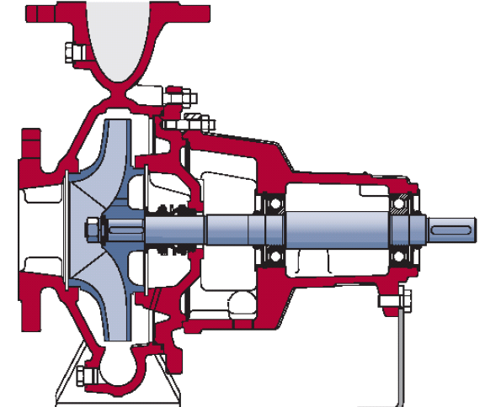
PERFORMANCE MONITORING OF PUMPS

Slide 2
TOPICS THAT WOULD BE COVERED
• PUMP DEFINITION
• CLASSIFICATION OF PUMPS
• COMPONENTS OF PUMP
• PUMP ASSESSMENT STUDY – PUMP EFFICIENCY
• CHARACTERISTICS CURVE
PUMP SELECTION & MODIFICATION
• NPSH, AFFINITY LAWS
PARALLEL/SERIES OPERATIONS IN PUMPS
• FACTORS AFFECTING PUMP PERFORMANCE

Slide 3
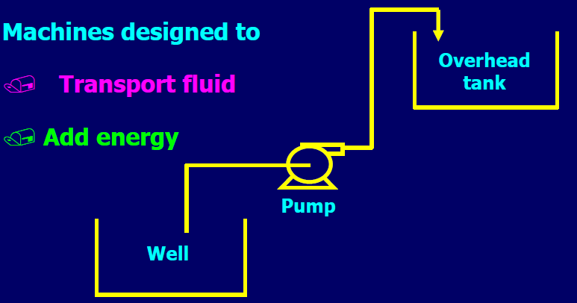
DEFINITION OF PUMP
PUMP IS A MECHANICAL DEVICE WHICH RAISES THE ENERGY LEVELS OF VARIOUS FLUIDS BY CONVERTING KINETIC ENERGY IMPARTED BY ITS PRIME MOVERS INTO HYDRAULIC ENERGY.
PUMP IS A MACHINE USED TO LIFT WATER FROM A LOWER LEVEL TO A HIGHER LEVEL.

Slide 4
PUMPS CLASSIFICATION

Slide 5
PUMPS CLASSIFICATION
PUMPS ARE OF 2 TYPES – POSITIVE DISPLACEMENT AND ROTODYNAMIC
POSITIVE DISPLACEMENT PUMPS ARE THOSE IN WHICH LIQUID IS SUCKED AND THEN PUSHED DUE TO THE THRUST EXERTED ON IT BY A MOVING MEMBER ,WHICH RESULTS IN LIFTING THE LIQUID TO THE REQUIRED HEIGHT.
EXAMPLES – RECIPROCATING PUMPS, DOSING PUMPS, PLUNGER PUMPS,SCREW PUMPS
ROTODYNAMIC PUMPS HAVE A ROTATING ELEMENT ,CALLED IMPELLER,THROUGH WHICH AS THE LIQUID PASSES ITS ANGULAR MOMENTUM CHANGES ,DUE TO WHICH THE PRESSURE ENERGY OF THE LIQUID IS INCREASED.
EXAMPLES – CENTRIFUGAL PUMPS , CENTRIPETAL PUMPS
Velocity energy ➔ Pressure energy
(Kinetic energy)

Slide 6
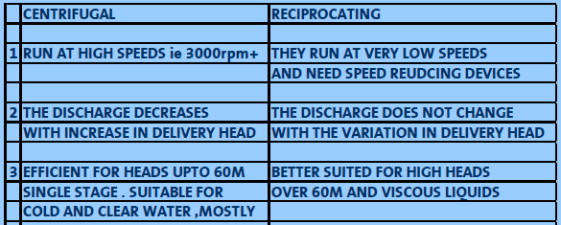
CENTRIFUGAL v/s RECIPROCATING PUMPS

Slide 7
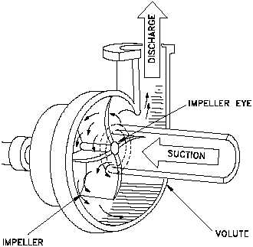
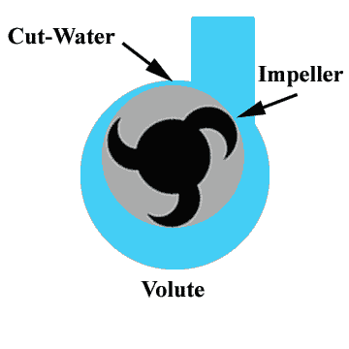
Centrifugal Pumps

Slide 8
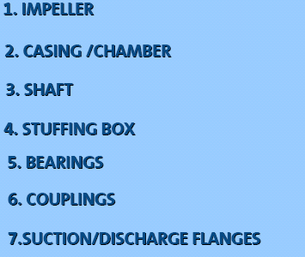
COMPONENTS OF PUMP

Slide 9
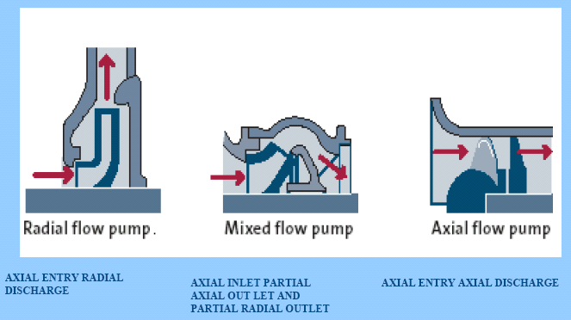
COMPONENTS OF PUMP - IMPELLER

Slide 10
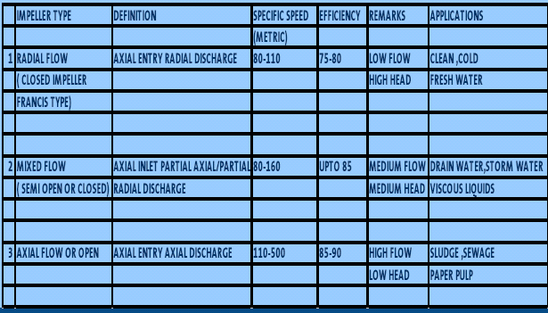
COMPONENTS OF PUMP - IMPELLER

Slide 11
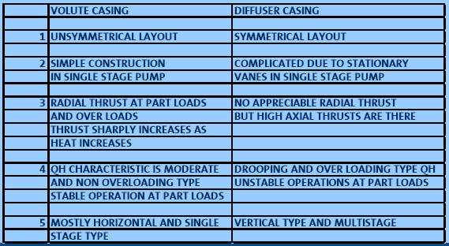
COMPONENTS OF PUMP - CASING

Slide 12
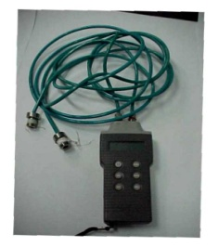
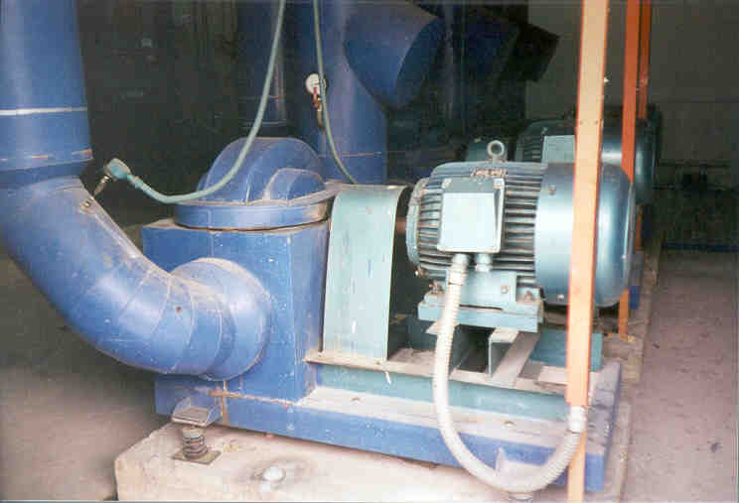
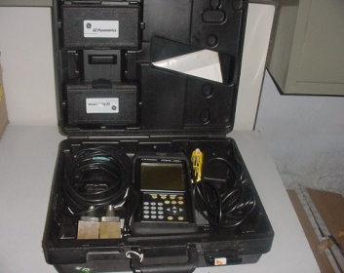
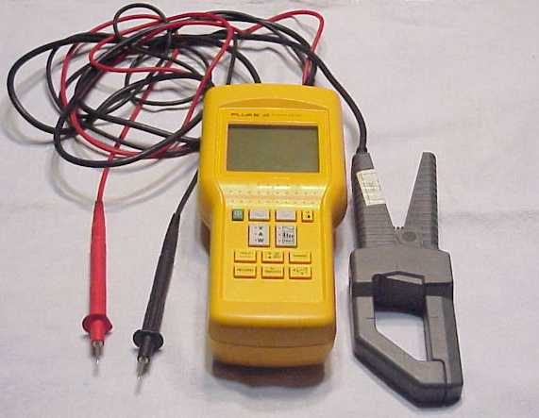
Pump Assessment Study
Pump head
Pump motor input kW
Water flow rate

Slide 13
Pump Efficiency
Hydraulic power P_{h} = Q (m³/s) x Total head, h_{d} - h_{s} (m) x  (kg/m³) x g (m²/s) 1000
Where h_{d} - discharge head, h_{s} – suction head,  - density of the fluid, g – acceleration due to gravity
Pump shaft power, P = Electrical input power* _{Motor}
Pump efficiency, _{Pump} = Hydraulic power, P_{h} Pump shaft power P_{s}

Slide 14
System Characteristics Curve
Static head
Difference in height of the supply and destination reservoirs
(static discharge head – static suction head)

Slide 15
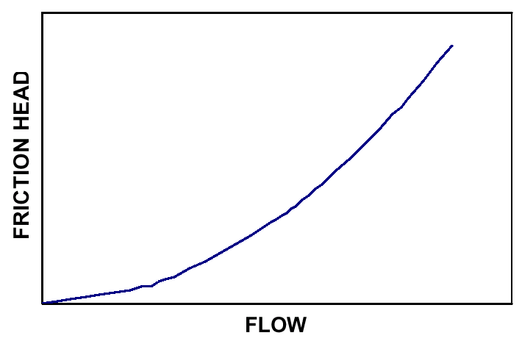
System Characteristics Curve
Dynamic (Friction) head
Resistance to flow in pipe and
fittings
Proportional to the square of the
flow rate
Closed loop system only has
friction head

Slide 16
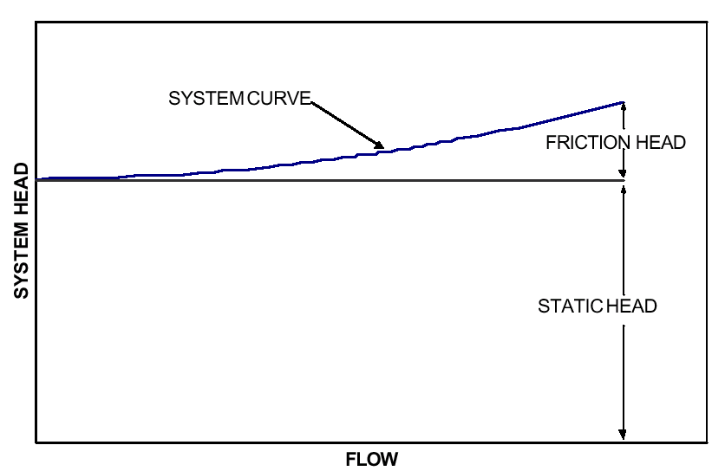
System with high static head
Total head = static head + friction head

Slide 17
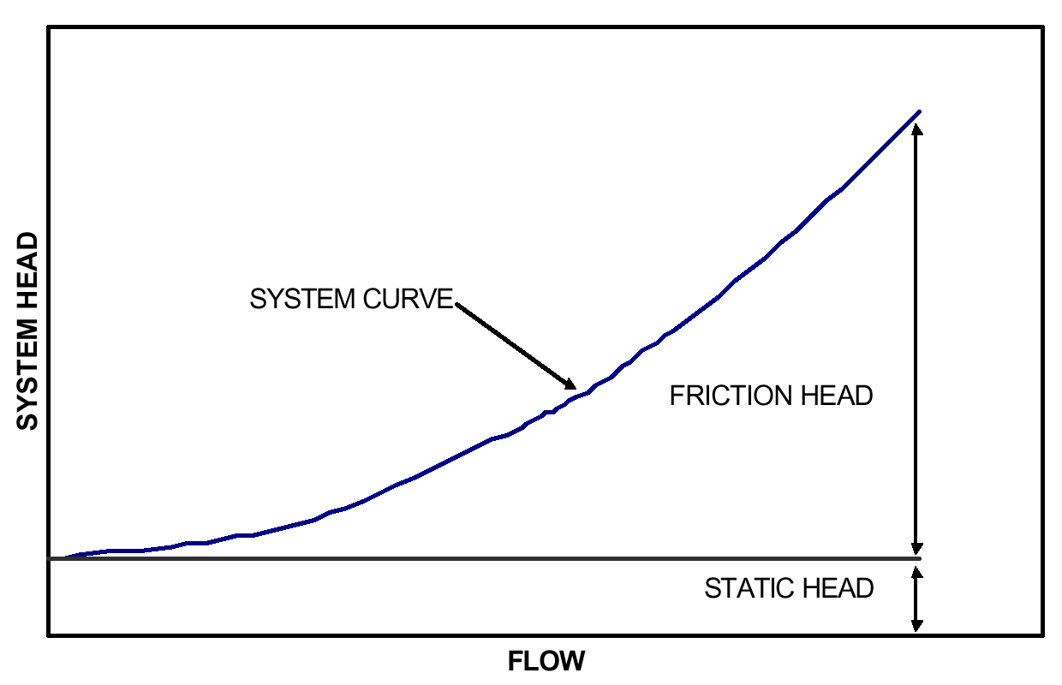
System with low static head
Total head = static head + friction head

Slide 18
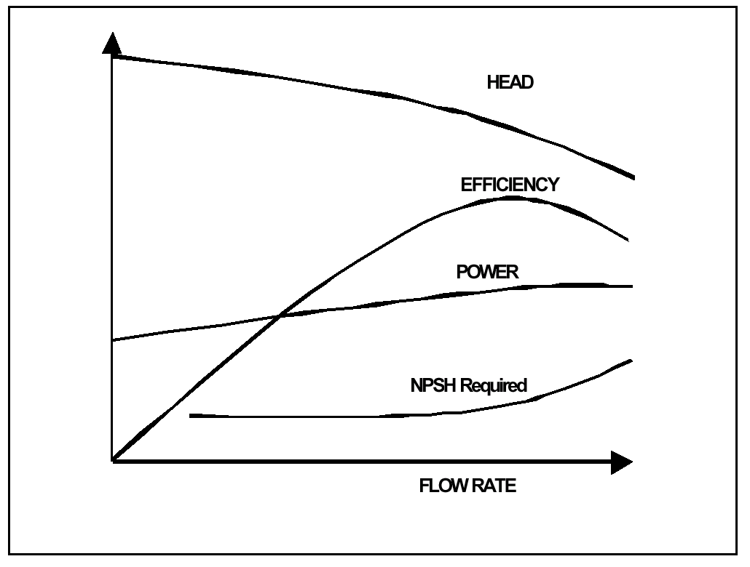
Pump Characteristics Curve

Slide 19
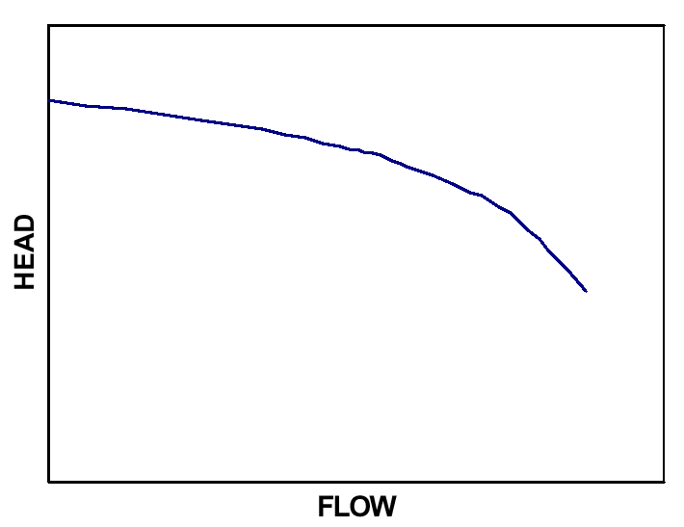
Pump curve

Slide 20
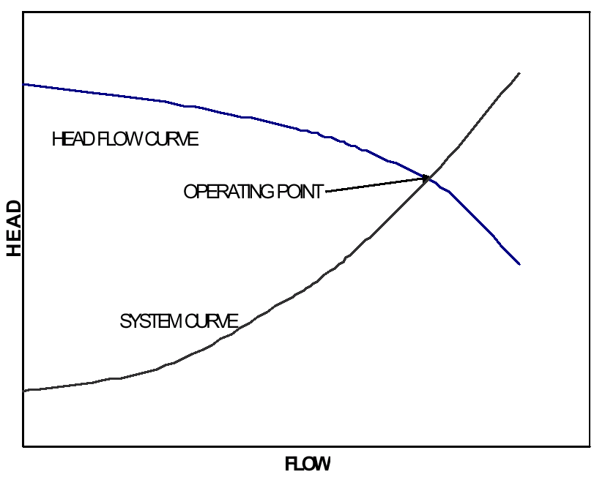
Pump operating point
BEP

Slide 21
Pump Selection – System & Pump Curve
Pump Curve at
Const. Speed
82%
50 m
Operating Point
System Curve
Head
Meters
500 m³/hr
Flow (m
3
/hr)

Slide 22
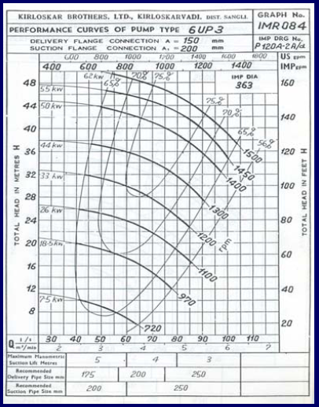
Iso-Efficiency Curves
Notes:
Use the white board and do the following
Assume that we need to pump 68 m3/hr. to a 47 meter head with a pump that is 60% efficient at that point.
Liquid Power - 68 x 47 / 360 = 8.9 Kw
Where ‘360’ is a constant
Shaft Power - 8.9 / 0.60 = 14.8 Kw
Where 0.6 is the efficiency at that point
Motor Power - 14.8 / 0.9 = 16.4 Kw
Where 0.9 is the motor efficiency
As shown in the drawing, we should be using impeller "E" to do this, but we have an oversized pump so we are using the larger impeller "A" with the pump discharge valve throttled back to 68 cubic meters per hour, giving us an actual head of 76 meters.
Now our Kilowatts look like this:
68 x 76 / 360 = 14.3 Kw being produced by the pump, and 14.3 / 0.50 = 28.6 Kw required to do this. Subtracting the amount of kilowatts we should have been using gives us: 28.6 - 14.8 = 13.8 extra kilowatts being used to pump against the throttled discharge valve.
Extra energy used - 8760 hrs/yr x 13.8 = 120,880 kw.
= $ 10,000/annum
In this example the extra cost of the electricity could almost equal the cost of purchasing two or three pumps.

Slide 23
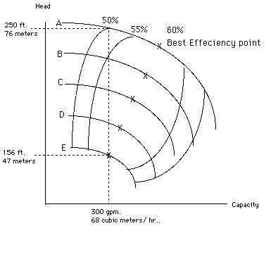
Iso-Efficiency Curves
A
E
Notes:
Use the white board and do the following
Assume that we need to pump 68 m3/hr. to a 47 meter head with a pump that is 60% efficient at that point.
Liquid Power - 68 x 47 / 360 = 8.9 Kw
Where ‘360’ is a constant
Shaft Power - 8.9 / 0.60 = 14.8 Kw
Where 0.6 is the efficiency at that point
Motor Power - 14.8 / 0.9 = 16.4 Kw
Where 0.9 is the motor efficiency
As shown in the drawing, we should be using impeller "E" to do this, but we have an oversized pump so we are using the larger impeller "A" with the pump discharge valve throttled back to 68 cubic meters per hour, giving us an actual head of 76 meters.
Now our Kilowatts look like this:
68 x 76 / 360 = 14.3 Kw being produced by the pump, and 14.3 / 0.50 = 28.6 Kw required to do this. Subtracting the amount of kilowatts we should have been using gives us: 28.6 - 14.8 = 13.8 extra kilowatts being used to pump against the throttled discharge valve.
Extra energy used - 8760 hrs/yr x 13.8 = 120,880 kw.
= $ 10,000/annum
In this example the extra cost of the electricity could almost equal the cost of purchasing two or three pumps.

Slide 24
If we select E, then the pump efficiency is 60%
Hydraulic Power = Q (m³/s) x Total head, h_{d} - h_{s} (m) x  (kg/m³) x g (m²/s) 1000
= (68/3600) x 47 x 1000 x 9.81
1000
= 8.7 kW
Shaft Power - 8.7 / 0.60 = 14.5 kW
Motor Power - 14.5 / 0.9 = 16.1kW (considering a motor efficiency of 90%)

Slide 25
If we select A, then the pump efficiency is 50%
Hydraulic Power = Q (m³/s) x Total head, h_{d} - h_{s} (m) x  (kg/m³) x g (m²/s) 1000
(68/3600) x 76 x 1000 x 9.81
1000
= 14 kW
Shaft Power - 14 / 0.50 = 28 Kw
Motor Power - 28 / 0.9 = 31 Kw (considering a motor efficiency of 90%)

Slide 26
Iso-Efficiency Curves
28 kW
A
E
14.5 kW
Notes:
Use the white board and do the following
Assume that we need to pump 68 m3/hr. to a 47 meter head with a pump that is 60% efficient at that point.
Liquid Power - 68 x 47 / 360 = 8.9 Kw
Where ‘360’ is a constant
Shaft Power - 8.9 / 0.60 = 14.8 Kw
Where 0.6 is the efficiency at that point
Motor Power - 14.8 / 0.9 = 16.4 Kw
Where 0.9 is the motor efficiency
As shown in the drawing, we should be using impeller "E" to do this, but we have an oversized pump so we are using the larger impeller "A" with the pump discharge valve throttled back to 68 cubic meters per hour, giving us an actual head of 76 meters.
Now our Kilowatts look like this:
68 x 76 / 360 = 14.3 Kw being produced by the pump, and 14.3 / 0.50 = 28.6 Kw required to do this. Subtracting the amount of kilowatts we should have been using gives us: 28.6 - 14.8 = 13.8 extra kilowatts being used to pump against the throttled discharge valve.
Extra energy used - 8760 hrs/yr x 13.8 = 120,880 kw.
= $ 10,000/annum
In this example the extra cost of the electricity could almost equal the cost of purchasing two or three pumps.

Slide 27
Using oversized pump !
As shown in the drawing, we should be using impeller "E" to do this, but we have an oversized pump so we are using the larger impeller "A" with the pump discharge valve throttled back to 68 cubic meters per hour, giving us an actual head of 76 meters.
Hence, additional power drawn by A over E is 31 –16.1 = 14.9 kW.
Extra energy used – (24*365) hrs/yr x 14.9 = 1,30,524 kWh/yr.
@Rs.4/kW= Rs. 5,22,096/annum
In this example, the extra cost of the electricity is more than the cost of purchasing a new pump.

Slide 28
Pump Selection - Modification
Pump Curve at
Const. Speed
82%
50
Operating Point
Head,
m
System Curve
300
500
Flow (m
3
/hr)

Slide 29
Pump Selection - Modification
Operating Points
Pump Curve at
Const. Speed
Pump Efficiency
77%
Partially
70
closed valve
B
82%
50
Full open valve
Head,
m
A
System Curves
300
500
3
Flow (m
/hr)

Slide 30
Pump Selection - Modification
Pump Curve at
Const. Speed
Operating Points
82%
A
50 m
Full open valve
42 m
System Curves
C
Head
Meters
Static
Head
3
3
300 m
/hr
500 m
/hr
3
Flow (m
/hr)

Slide 31
Pump Selection - Modification
Pump Curve at
Pump Efficiency 77%
Const. Speed
Partially
B
70 m
82%
closed valve
A
50 m
Full open valve
42 m
System Curves
C
Head
Meters
3 Operating Points – A,B,C
Static
Head
3
3
300 m
/hr
500 m
/hr
3
Flow (m
/hr)

Slide 32
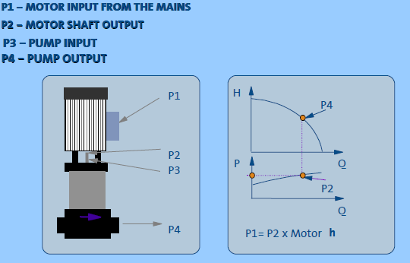
POWER CURVE

Slide 33
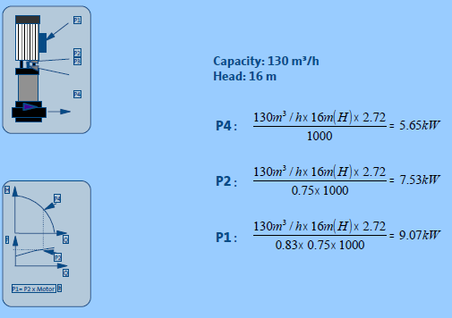
Example

Slide 34
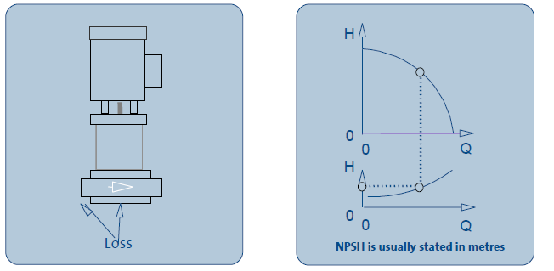
Net Positive Suction Head

Slide 35
NPSH

Slide 36
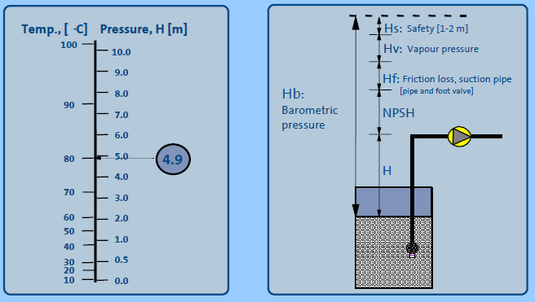
Vapour Pressure & Suction Lift

Slide 37
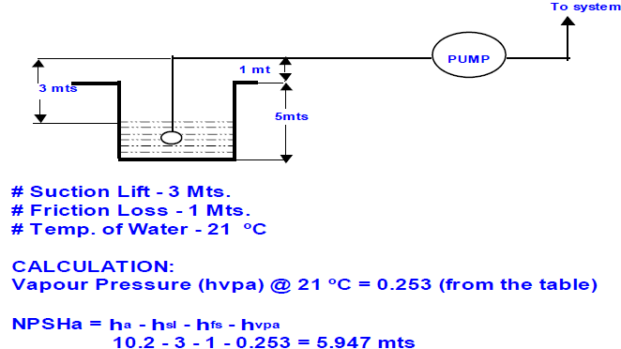
NPSH Calculations

Slide 38
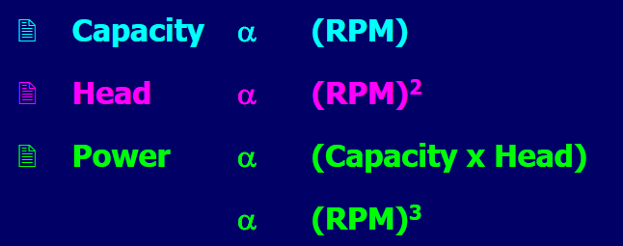
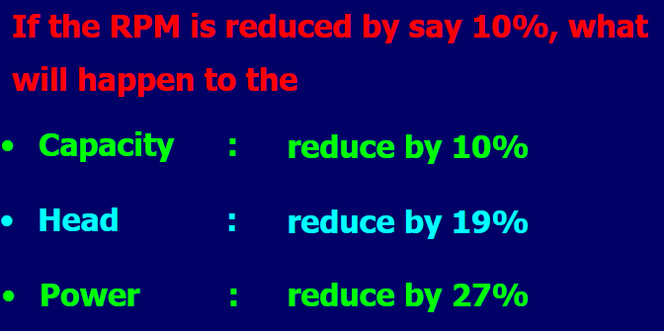
AFFINITY LAW

Slide 39
Effect of Variable Speed
Flow: Q1 / Q2 = N1 / N2
Example:
100 / Q₂ = 1750/3500
Q₂ = 200 m³/hr

Slide 40
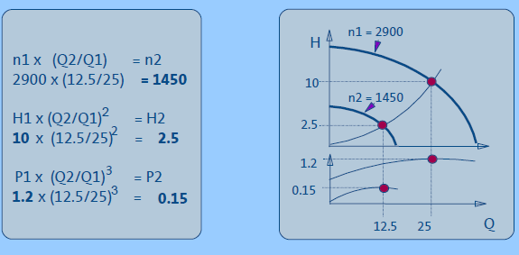
Effect of Variable Speed

Slide 41
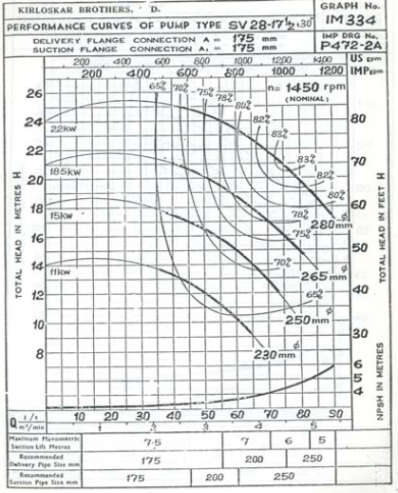
Effect of Variable Diameter

Slide 42
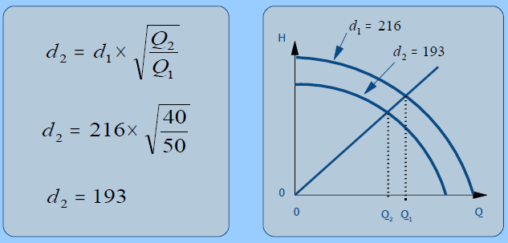
Impeller Trimming

Slide 43
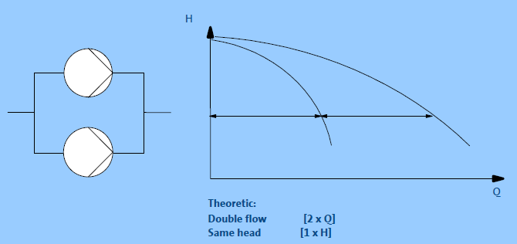
Parallel Operation of Similar Pump

Slide 44
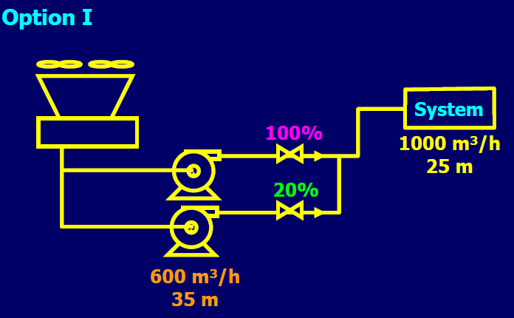
Parallel Pumping

Slide 45
Parallel Pumping

Slide 46
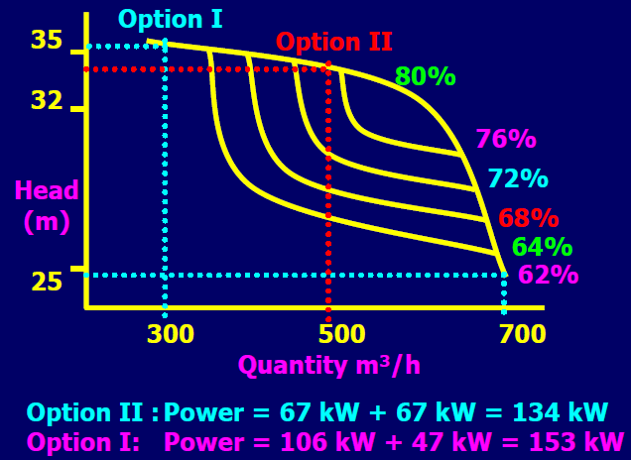
Parallel Pumping

Slide 47
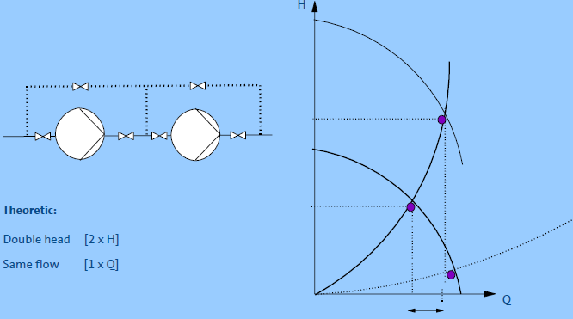
Series Operation of Similar Pump

Slide 48
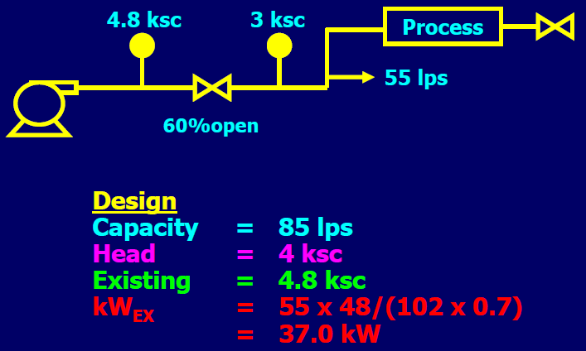
Effect of Valve Throttling

Slide 49
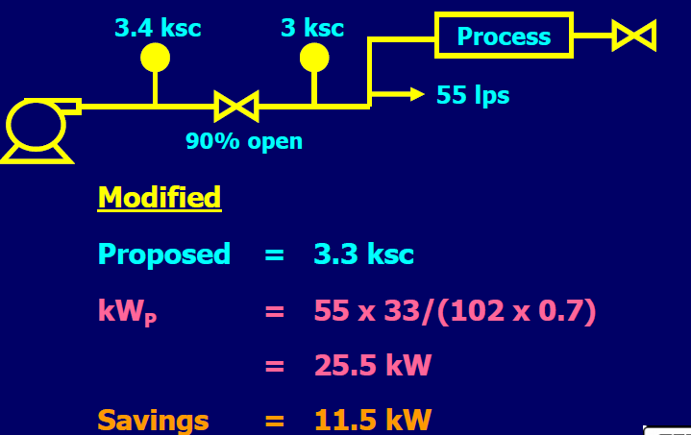
Effect of Valve Throttling

Slide 50
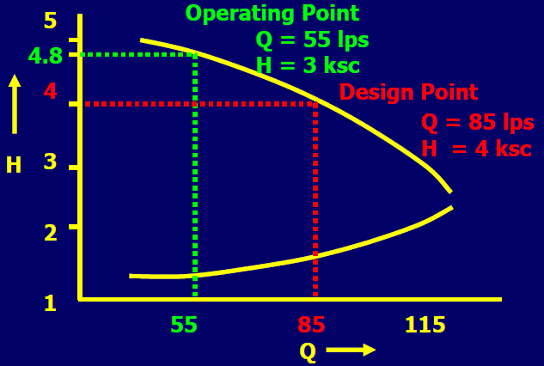
Operating Conditions of Over-designed Pump

Slide 51
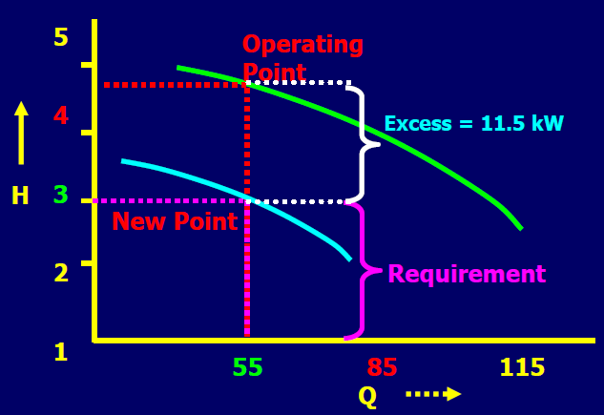
Operating Conditions of Over-designed Pump

Slide 52
Coatings of Hydraulic Passages

Slide 53
Coatings of Hydraulic Passages

Slide 54
Coatings of Hydraulic Passages

Slide 55
CONCLUSION

Slide 56
THANK YOU

