Slide 1
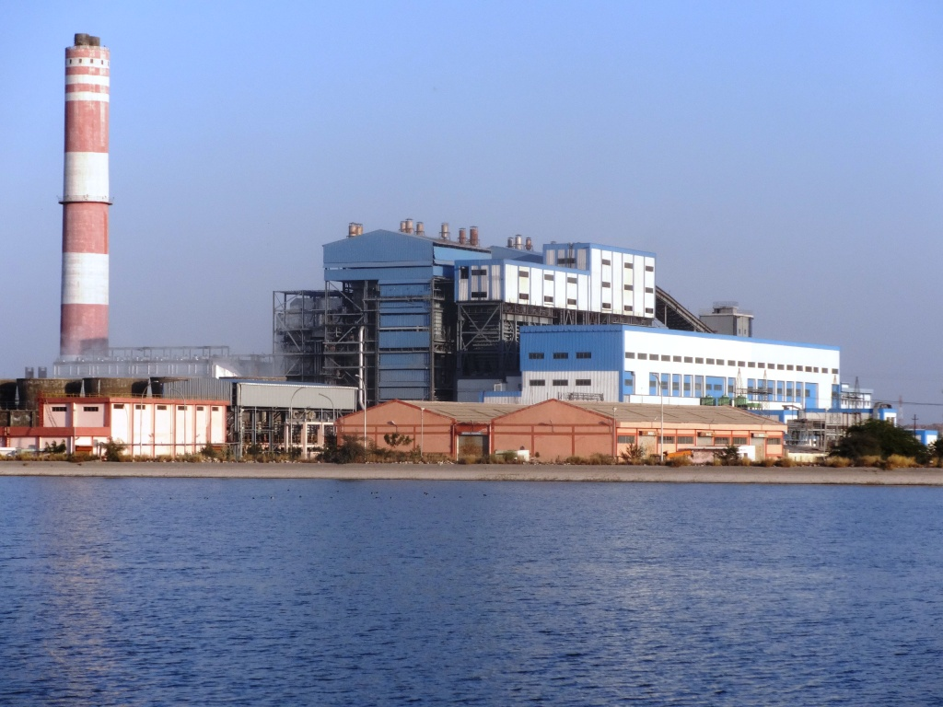
NLC India Limited
Barsingsar Thermal Power Station
Boiler Maintenance
WELCOME
BTL in CFBC Boiler- 2 X 125
BHUPENDRA KUMAR
DCE/BOILER MAINTENANCE

Slide 2
NLC India Limited
Barsingsar Thermal Power Station
Boiler Maintenance
MINES
INSTALLED CAPACITY | 2.1 MTPA
GOI APPROVAL | 15.12.2004
PROJECT COST | Rs 218.06 Crore
TYPE OF MINING | CONVENTIONAL

Slide 3
NLC India Limited
Barsingsar Thermal Power Station
Boiler Maintenance
THERMAL
INSTALLED CAPACITY | 2X125 MW
GOI APPROVAL | 15.12.2004
SOURCE OF WATER | IGNP CANAL (45 Cusec)
PROJECT COST | Rs 1868.71 Crore
TYPE OF BOILER | CFBC TECHNOLOGY

Slide 4
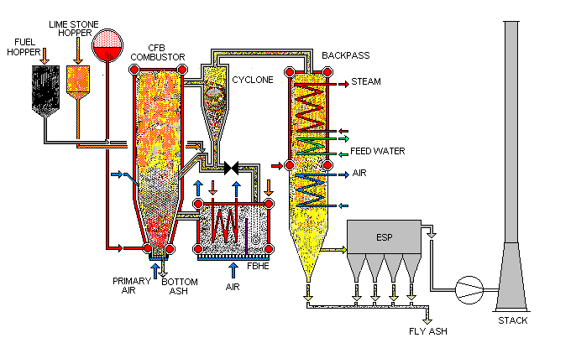
NLC India Limited
Barsingsar Thermal Power Station
Boiler Maintenance
GENERAL ARRANGEMENT OF CFBC BOILER - 125MW

Slide 5
NLC India Limited
Barsingsar Thermal Power Station
Boiler Maintenance
CFBC Boiler stands for circulating fluidized bed combustion boiler ,the furnace is pressurized and the furnace gas is re-circulated to capture the unburnt carbon, to increase the Thermal efficiency of the Boiler.

Slide 6
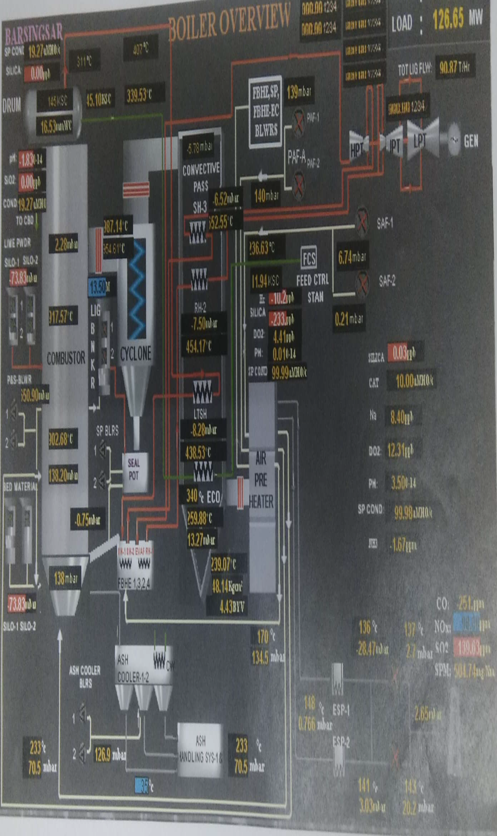
NLC India Limited
Barsingsar Thermal Power Station
Boiler Maintenance
BOILER OVERVIEW

Slide 7
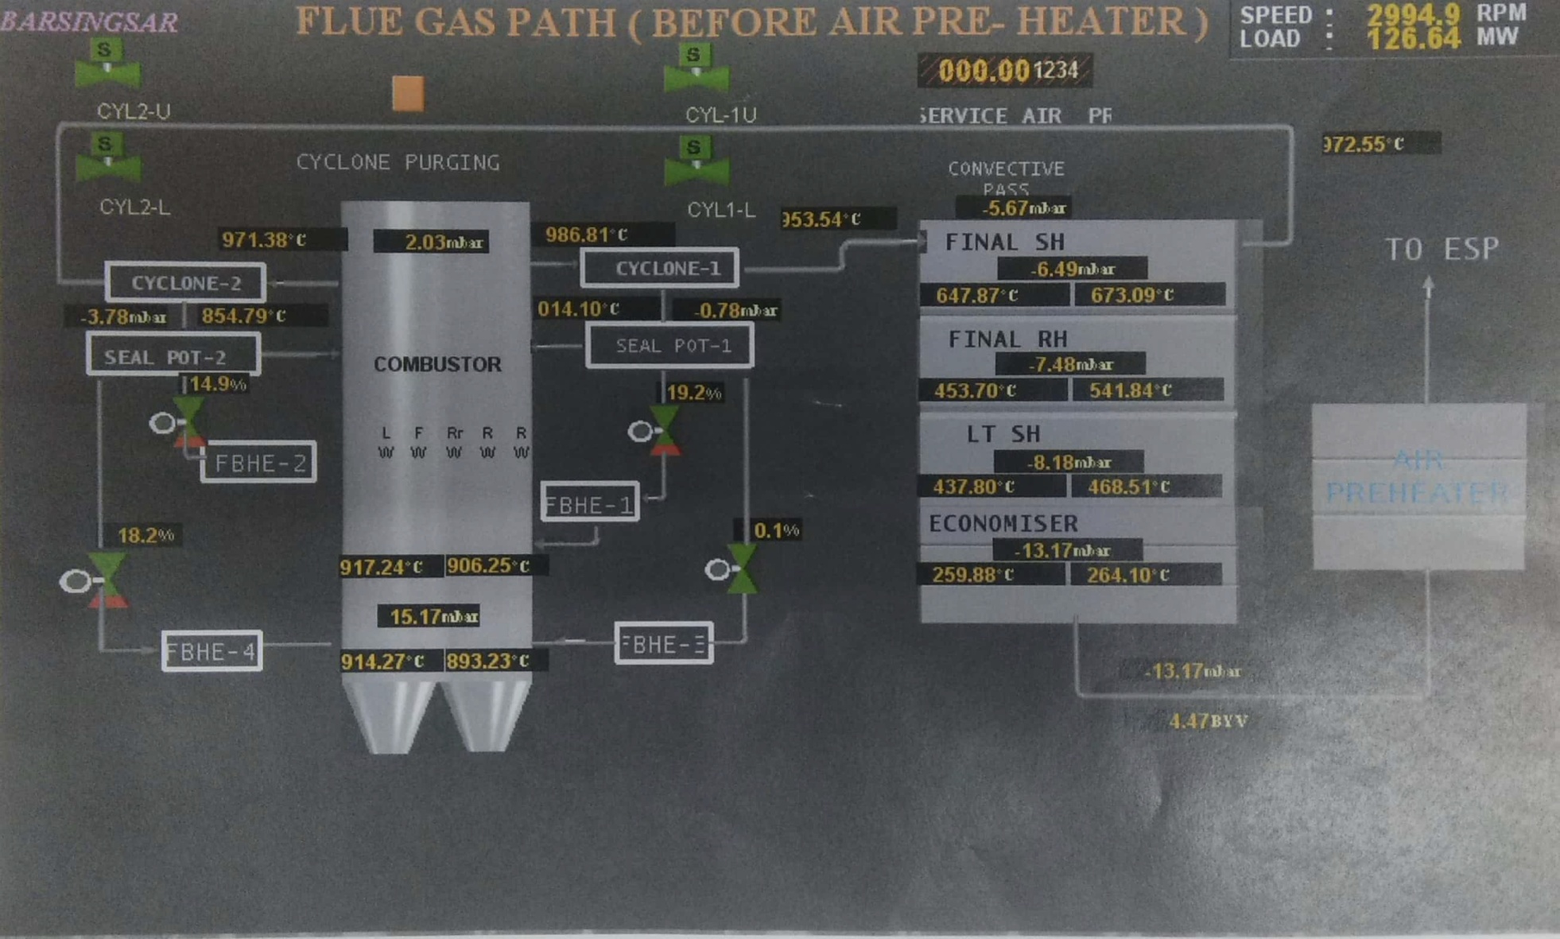
NLC India Limited
Barsingsar Thermal Power Station
Boiler Maintenance

Slide 8
NLC India Limited
Barsingsar Thermal Power Station
Boiler Maintenance
CFBC Boiler consist of two pass
First pass is surrounded by water wall with four number of integrated FBHE in each corner of the boiler and two cyclone
(one is left and another is right side of the boiler)
Second pass is surrounded by steam cooled wall. The flue gas after leaving the combustor passes through the final SH, final RH,LTSH coil which is supported by a hanger tubes and after economizer tube banks leaves the second pass.

Slide 9
NLC India Limited
Barsingsar Thermal Power Station
Boiler Maintenance
FLUIDIZATION
Fluidization is a process whereby a granular material is converted from a static solid to a dynamic fluid

Slide 10
NLC India Limited
Barsingsar Thermal Power Station
Boiler Maintenance
FBHE
FBHE is nothing but a heat exchanger. Out of four FBHE ,Two FBHE having SH coil, one FBHE having RH coil and one FBHE having evaporator coil

Slide 11
NLC India Limited
Barsingsar Thermal Power Station
Boiler Maintenance
CFBC
In the cyclone the heavier particles separate from the gas and falls to the hopper of the cyclone. This returns to the furnace for recirculation. Hence the name is circulating fluidized bed combustion

Slide 12
NLC India Limited
Barsingsar Thermal Power Station
Boiler Maintenance
SYNCHRONISATION | Unit-1 | 27.10.2009 | Unit-2 | 05.06.2010
COD | Unit-1 | 20.01.2012 | Unit-2 | 29.12.2011
MAJOR CHALLANGE FACED IN 2011-12,2012-13
CYCLONE CHOKE
NO OF CYCLONE CHOKES : 14 NOS
GENERATION HOURS LOST: 5004 HOURS

Slide 13
BARSINGSAR LIGNITE AND ASH ANALYSIS
(PROF HUPA &ASSOCIATES) FROM ABO ACADEMY UNIVERSITY, FINLAND, RENOWNED EXPERTS IN CFB ASH CHEMISTRY
Analysed The Barsingsar Lignite And Ash And Came To Following Conclusion.
In Barsingsar lignite ash , shrinkage phenomena starts at 860ºC and nearly 25% shrinkage was observed as temperature reached in vicinity of 860 to 900ºCtemperature band
Shrinkage of fresh Lignite ash from 15% to 40% leading to solid phase sintering
The unique nature of fuel ash is major contributory factor for particle sintering and resulting cyclone chocking.
it is very clear that the lignite is quite unique in its behaviour and has a very significant shrinkage at about 860ºC.
Shrinkage does not occur on the choked cyclone ash

Slide 14
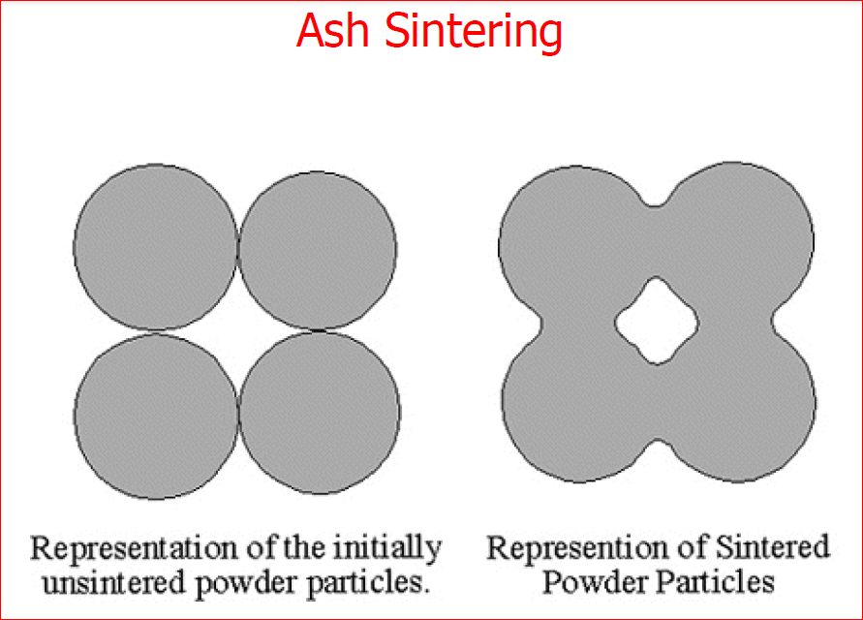
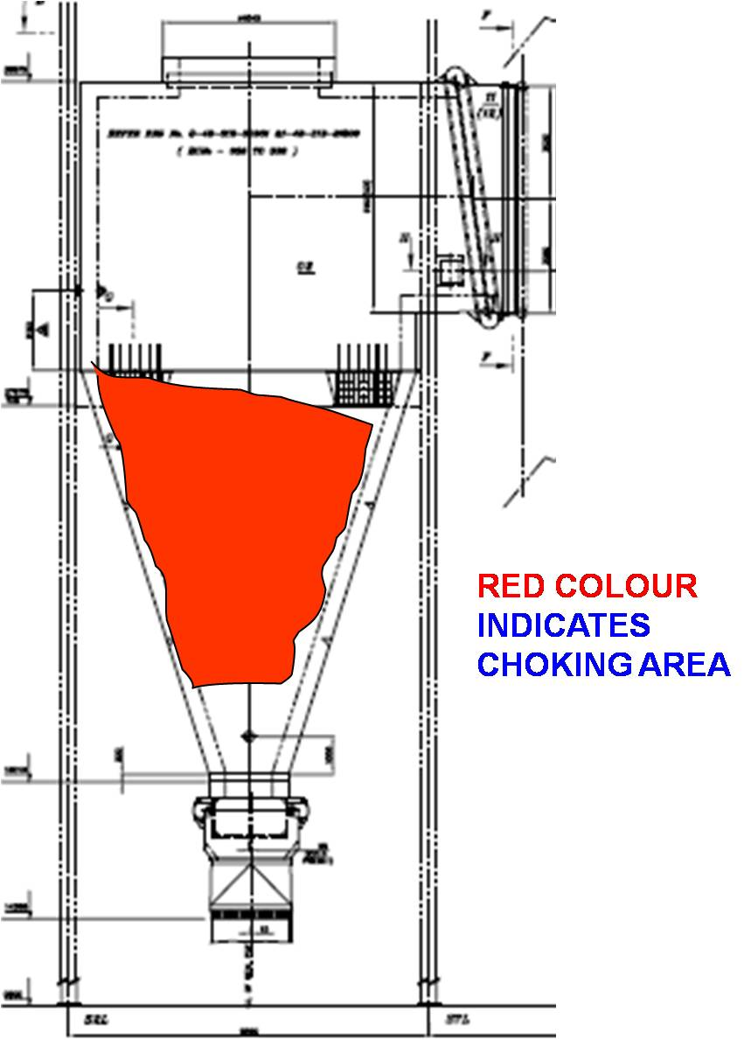
NLC India Limited
Barsingsar Thermal Power Station
Boiler Maintenance
Ash Sintering and cyclone choke

Slide 15
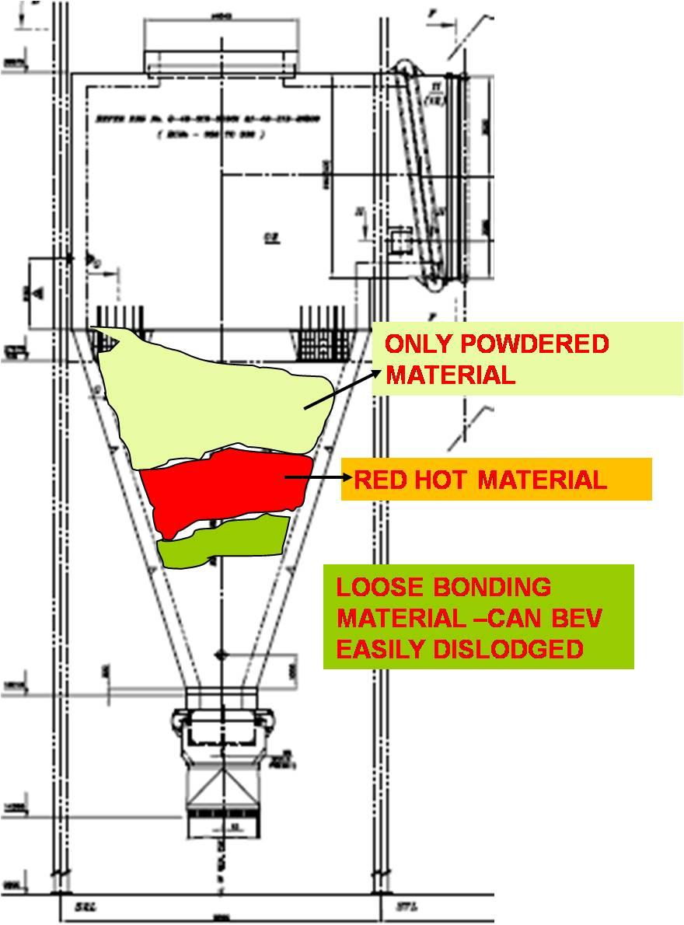
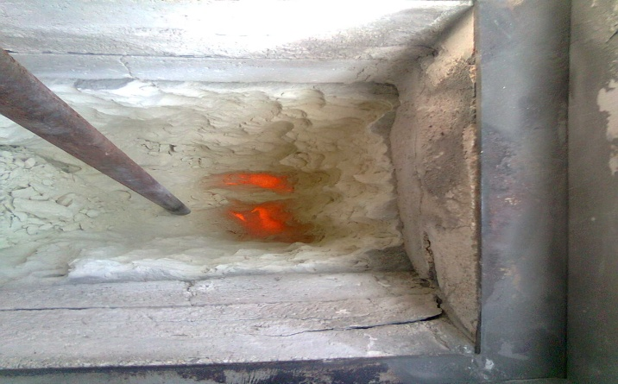
NLC India Limited
Barsingsar Thermal Power Station
Boiler Maintenance
CYCLONE CHOKE A VIEW FROM SEAL POT

Slide 16
NLC India Limited
Barsingsar Thermal Power Station
Boiler Maintenance
RECOMMENDATION BY BHEL TO AVOID CYCLONE CHOKE
In view of the unique behaviour of lignite, the operational procedure of the CFB boiler is changed to operate the boiler maintaining uniformly higher temperature in combustor (around 900ºC (>860ºC)).
The intention of this change is to ensure that ash faces the higher temperature in combustor where fluidisation atmosphere would take care of the shrinkage behaviour and thermally treat the ash before it enters cyclone.
As observed, the ash subsequently does not exhibit this shrinkage behaviour, it would be safe to admit the ash without risk`of cyclone chocking.

Slide 17
NLC India Limited
Barsingsar Thermal Power Station
Boiler Maintenance
REVISION OF OPERATING PARAMETERS AT FULL LOAD
 | DESIGN DEG C | REVISED/EXISTING DEG C
COMBUSTOR TEMPERATURE | 780 | 880 to 900
CYCLONE I/L TEMP | 850 | 960
CYCLONE O/L TEMP | 850 | 960 TO1020
FG TEMP AT SH INLET | 798 | 945 TO 980
SEAL POT TEMP | 900 | 980 TO 1000

Slide 18
NLC India Limited
Barsingsar Thermal Power Station
Boiler Maintenance
CONSEQUENCES OF HIGHER OPERATING TEMPERATURE
HIGHER SH AND RH SPRAY WATER FLOW
HIGHER BACK PASS TEMPERATURE
FREQUENT PRESSURE PARTS FAILURE
FREQUENT REFRATORY DAMAGES
COMBUSTOR TO CYCLONE NMEJ DAMAGES
TO AVOID LEAKAGES IN NMEJ SHIFTING OF NULL POINT LEADING TO HIGHER LOADING OF ID FANS.

Slide 19
NLC India Limited
Barsingsar Thermal Power Station
Boiler Maintenance
Sl. No: | Year | 2011-12 |  | 2012-13 |  | 2013-14 |  | 2014-15 |  | 2015-16 |  | 2016-17 |  | 2017-18 |  | 2018-19 |  | Total
 |  | U1 | U2 | U1 | U2 | U1 | U2 | U1 | U2 | U1 | U2 | U1 | U2 | U1 | U2 | U1 | U2
1 | Combustor water wall |  |  | 2 |  |  |  |  |  | 2 |  |  | 2 |  |  | 2 | 1 | 9
2 | seal pot WW |  | 3 |  |  | 1 |  |  |  |  |  |  |  |  |  |  |  | 4
3 | Lignite path water wall |  |  |  |  |  |  |  | 1 |  |  | 1 | 1 | 1 |  |  |  | 4
4 | FBHE-1 water wall |  |  |  |  |  |  |  | 1 |  |  |  |  |  | 2 |  | 1 | 4
5 | FBHE-2 water wall |  |  |  |  |  |  |  |  |  |  |  |  |  |  |  |  | 0
6 | FBHE-3 water wall |  | 1 |  |  |  |  |  |  |  |  |  |  |  |  |  |  | 1
7 | FBHE-4water wall |  |  | 2 |  |  |  |  |  |  |  |  |  |  | 2 | 2 | 1 | 7
8 | FBHE-1 RH coils |  |  |  |  |  |  |  |  |  |  |  |  |  |  |  |  | 0
9 | FBHE-2 SH coils |  |  |  |  |  |  |  | 1 |  |  |  |  | 1 |  |  |  | 2
10 | FBHE-3 SH coils |  |  |  |  |  |  |  |  |  |  |  |  |  |  |  |  | 0
11 | FBHE-4 Evaporator coil |  |  |  |  |  |  | 1 |  |  |  |  |  | 1 |  |  |  | 2
12 | FSH coils | 1 | 2 | 1 | 1 |  |  |  |  |  |  |  |  |  |  |  |  | 5
13 | LTSH |  |  |  |  |  |  |  |  |  |  |  |  |  |  |  |  | 0
14 | Back pass hanger tube |  |  | 1 | 1 | 1 | 2 | 1 | 1 |  | 1 |  | 1 |  |  |  |  | 9
15 | Back pass SH SCC - Roof |  |  |  |  | 4 |  | 4 | 1 | 3 | 4 | 1 | 1 |  |  |  |  | 18
16 | Back pass SH SCC - side wall |  |  |  |  |  |  |  |  |  |  |  |  |  |  |  |  | 0
17 | Economizer tube |  |  |  |  |  |  | 3 |  | 1 | 2 | 2 | 1 |  | 2 |  |  | 11
Unit wise Total B T failures |  | 1 | 6 | 6 | 2 | 6 | 2 | 9 | 5 | 6 | 7 | 4 | 6 | 3 | 6 | 4 | 3 | 76
Station Boiler Tube Failures |  | 7 |  | 8 |  | 8 |  | 14 |  | 13 |  | 10 |  | 9 |  | 7

Slide 20
NLC India Limited
Barsingsar Thermal Power Station
Boiler Maintenance
BOILER TUBE FAILURES ANALYSIS
LOCATION | NUMBER OF FAILURE | ROOT CAUSE
ECONOMISER | 11 | EROSION
FBHE WW AND COILS | 8 | REFRACTORY FAILUE AND THERMAL STRESS CREEP,EROSION
WATER WALL IN COMBUSTOR,SEAL POT,LIGNITE PATH | 10 | REFRACTORY FAILURES AND EROSION
HANGER TUBE | 8 | EROSION
SH COIL | 5 | EROSION
BACK PASS STEAM COOLED ROOF TUBES | 18 | CONTINUOUS EXPOSURE TO HIGH TEMPERATURE AND CREEP

Slide 21
NLC India Limited
Barsingsar Thermal Power Station
Boiler Maintenance
BACK PASS ROOF SCW TUBES FAILURE ANALYSIS

Slide 22
NLC India Limited
Barsingsar Thermal Power Station
Boiler Maintenance
SCW roof tube failure
THICK LIP OPENINING

Slide 23
NLC India Limited
Barsingsar Thermal Power Station
Boiler Maintenance
Analysis of the failed tube by BHEL
The visual examination of the failed tube reveal bulging and burst open with thick lip opening at the region adjacent to fin weld joint.
The burst lip reveals oxidation of edges both inside and outside of the tube.
Several oxidised grain boundary creep cavities with notches observed outside surface of the tube.
Decarbonisation in the gains of the burst open lip.
The burst lip and opposite side of the burst lip shows polygonal grains of ferrites and completely spheroidised and partially dispersed carbides indicating the over heating of the tubes.
The section little away from the failure shows similar microstructure indicating over heating throughout the section of the tube.
The lab report confirms the primary cause of the tube failure is due overheating above the design temperature . The tube metal temperature also reveals the same.

Slide 24
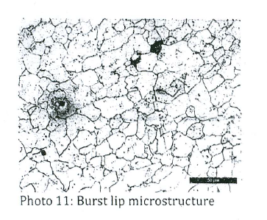
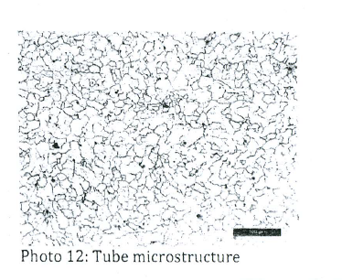
NLC India Limited
Barsingsar Thermal Power Station
Boiler Maintenance
Micro structure analysis of the SCW failed roof tube

Slide 25
NLC India Limited
Barsingsar Thermal Power Station
Boiler Maintenance
Conclusion of SCW roof tube failure.
Due revised operating temperature of the boiler ,the back pass roof tubes are subjected to very high temperature of about 980 C to 1030 C.
This is confirmed by the tube metal temperature measurement in the range of 500 C to 530 C against design temperature of roof tube material i(SA 210 Gr A1) of 400C.
The roof tubes are continuously subjected very high temperature leading to micro structure deformation and formation of creep cavities.
The deformation of structure lead to reduction of tensile strength and burst open along the creep cavities.

Slide 26
NLC India Limited
Barsingsar Thermal Power Station
Boiler Maintenance
OXIDATION LIMITS:
MATERIAL DESCRIPTION | MATERIAL GRADE | OXIDATION LIMITS
Carbon Steel | SA 178, SA 210 ,SA 192 etc | 454ºC (850 º F )
C-1/2 Mo | SA 209 T1 | 482 º C (900º F)
1 ¼ Cr -1/2 Mo | SA 213 T11 | 552º C (1025º F)
2 ¼ Cr – 1 Mo | SA 213 T22 | 579º C (1075º F)
18 Cr – 8 Ni | SA 213 TP 304 | 704 ºC (1300º F)
18 Cr – 10 Ni | SA 213 321 H | 816ºC (1500º F)

Slide 27
NLC India Limited
Barsingsar Thermal Power Station
Boiler Maintenance
Recommendations by BHEL
Changing the metallurgy of the SCW roof panel from SA210 Gr A1 (carbon steel) to SA 213 T11 (alloy steel).
To adopt refractory lining at the bottom side of the SCW roof panel to reduce heat pick up in the roof panel.
Introduction of vortex finder to increase the ash circulation and reducing the back pass flue gas temperature.

Slide 28
NLC India Limited
Barsingsar Thermal Power Station
Boiler Maintenance
INITIATIVES TAKEN TO COUNTER THE SCW ROOF TUBE FAILURE
NEW METAL TEMPERATURE MEASURING POINTS INTRODUCED TO MONITER CONTINUOUSLY .
LOAD WAS MAINTAINED AROUND 100 TO 105 MW IN ORDER TO MAINTAIN ROOF METAL TEMP WITHIN 480c
REPLACEMENT OF TUBES WITH SA 213 T11 TUBES IN THE PUNCTURE PRONE AREAS

Slide 29
NLC India Limited
Barsingsar Thermal Power Station
Boiler Maintenance
MODIFICATION PROPOSAL
It was decided to replace the entire roof panel along with header. BHEL agreed to supply the entire material. The list of material is as follows
HEADER WITH STRAIGHT AND BEND NIPPLES
LOOSE TUBES DIA 35X6 mm OF SA 210 T11 MATERIAL
ALLOY STEEL LOOSE FIN PLATES
SEAL BOXES TO SEAL HANGER TUBES PENETRATION.

Slide 30
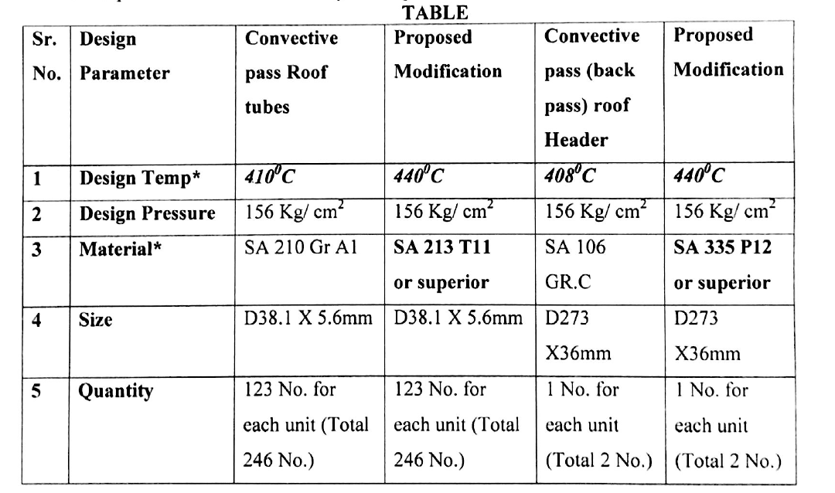
NLC India Limited
Barsingsar Thermal Power Station
Boiler Maintenance
Proposed modification

Slide 31
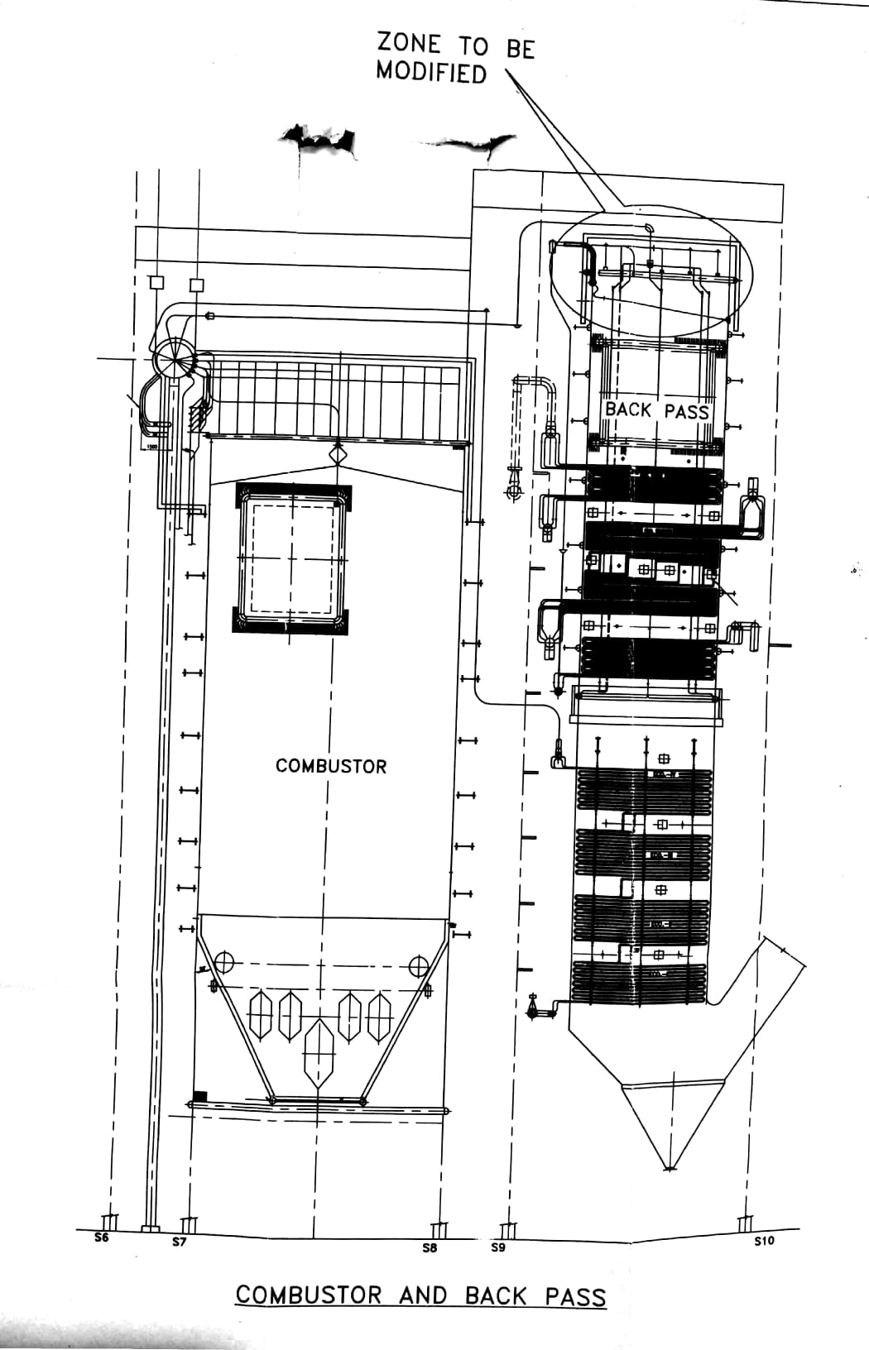
NLC India Limited
Barsingsar Thermal Power Station
Boiler Maintenance

Slide 32
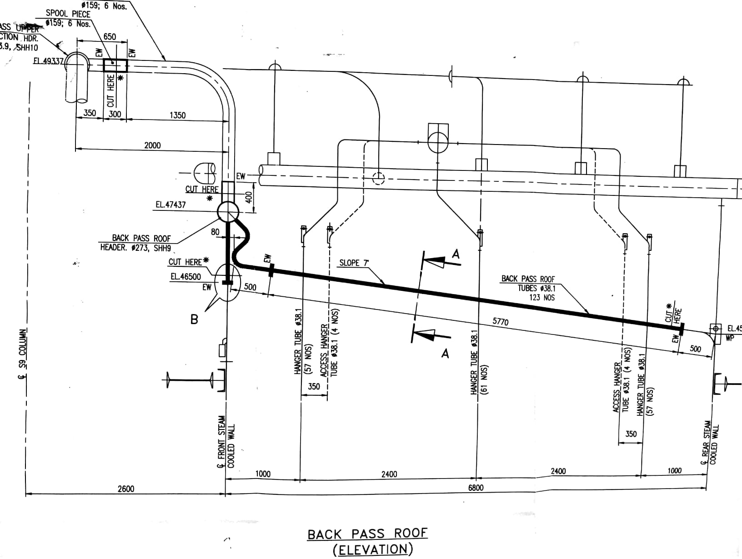
NLC India Limited
Barsingsar Thermal Power Station
Boiler Maintenance
ROOF SCW
HEADER
FRONT SCW

Slide 33
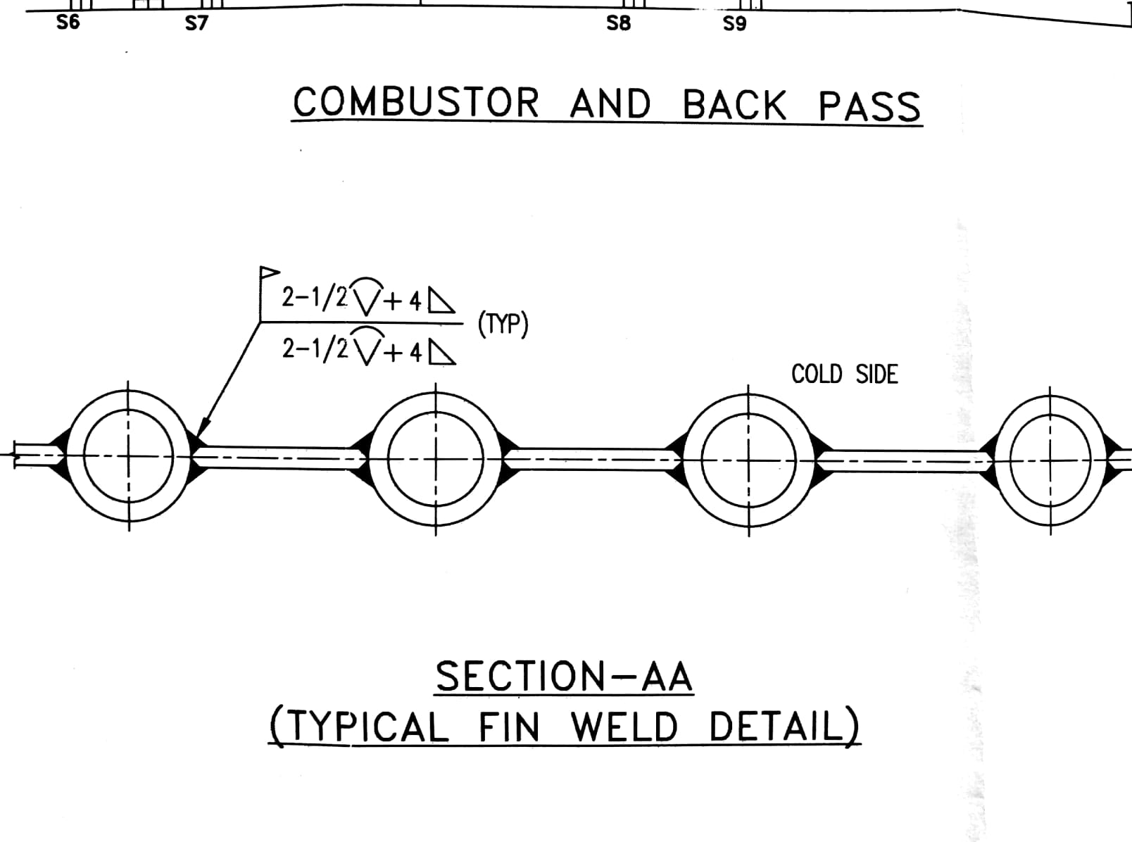
NLC India Limited
Barsingsar Thermal Power Station
Boiler Maintenance

Slide 34
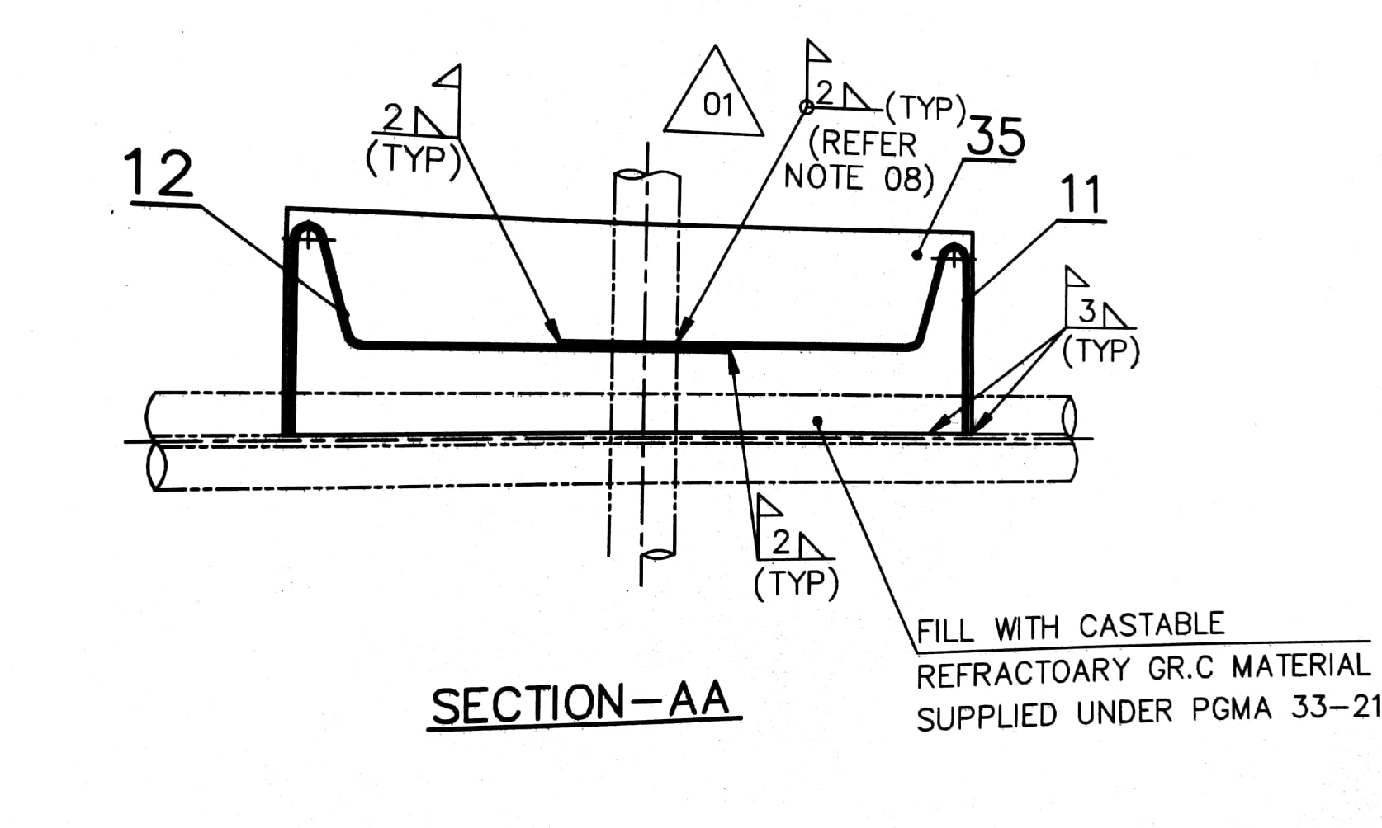
NLC India Limited
Barsingsar Thermal Power Station
Boiler Maintenance

Slide 35
NLC India Limited
Barsingsar Thermal Power Station
Boiler Maintenance

Slide 36
NLC India Limited
Barsingsar Thermal Power Station
Boiler Maintenance
Total number of weld joints: 3 x123 + 6 = 375 Joints (TIG & Arc welding)
Total length of welding between T 11 tube and alloy fin plate = 6000 meters.
All skin casing welding in all 3 hanger tube, front header and all scw panel seal welding.

Slide 37
NLC India Limited
Barsingsar Thermal Power Station
Boiler Maintenance
PERFORMANCE OF 2 X 125 MW CFBC BOILER
DESCRIPTION | 2013-14 | 2014-15 | 2015-16 | 2016-17 | 2017-18
GROSS GENERATION (MU) | 1437.92 | 1380.65 | 1285.56 | 1463.25 | 1648.797
PLF(%) | 65.66 | 63.04 | 58.54 | 66.82 | 75.29
OPLF(%) | 88.47 | 81.25 | 78.51 | 92.92 | 94.84
M/C AVAILABILITY(%) | 74.22 | 77.59 | 74.57 | 71.89 | 72.25
PLANNED OUTAGE(%) | 10.00 | 9.60 | 8.56 | 15.61 | 8.01
FORCED OUTAGE | 15.79 | 12.81 | 16.87 | 12.50 | 12.61

Slide 38
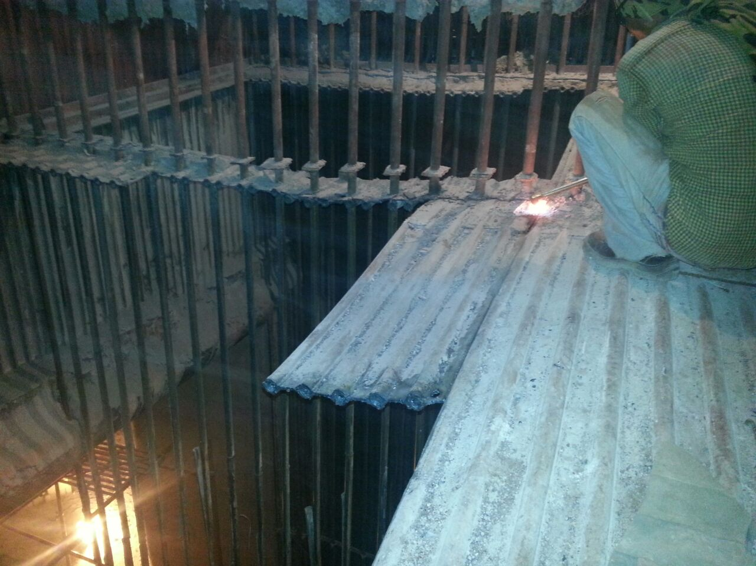
NLC India Limited
Barsingsar Thermal Power Station
Boiler Maintenance

Slide 39
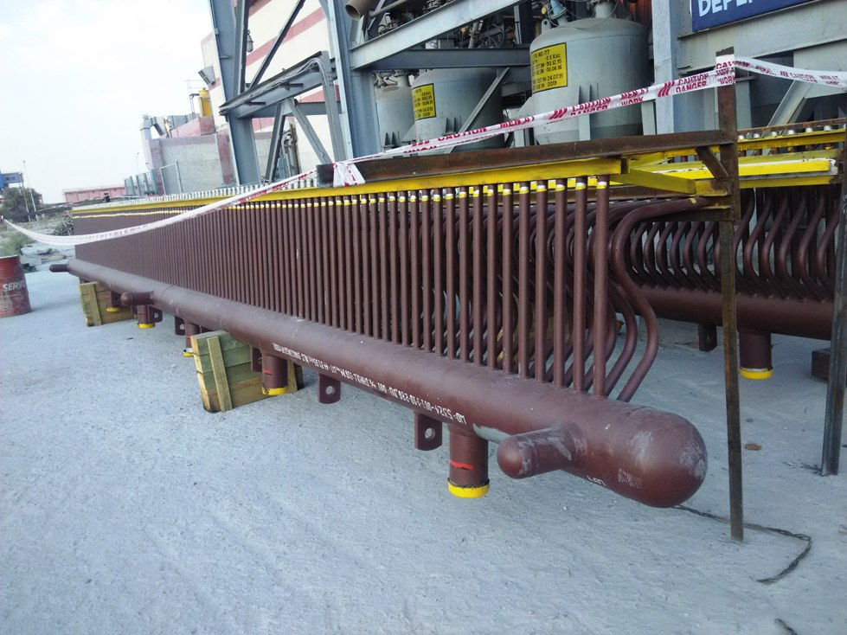
NLC India Limited
Barsingsar Thermal Power Station
Boiler Maintenance
BACK PASS SCW ROOF HEADER

Slide 40
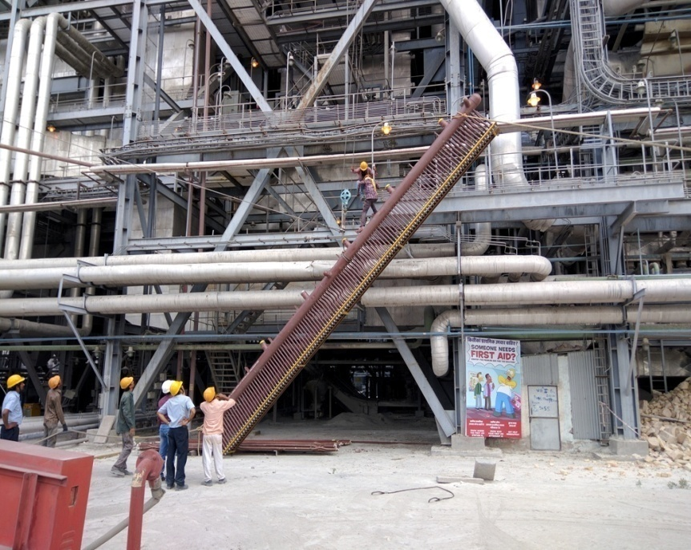
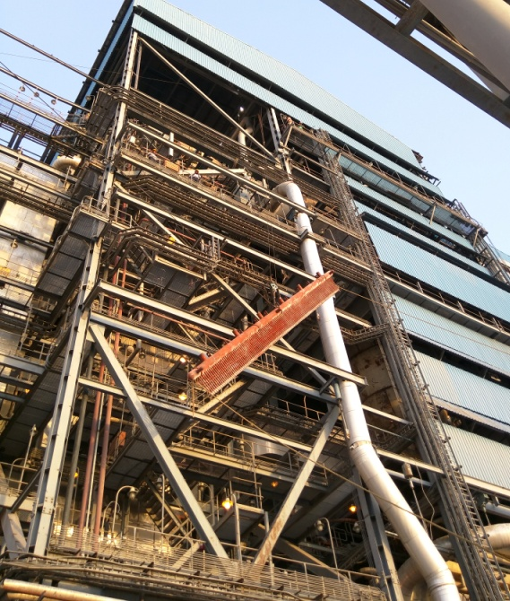
NLC India Limited
Barsingsar Thermal Power Station
Boiler Maintenance
RAISING OF STEAM COOLED WALL ROOF HEADER

Slide 41
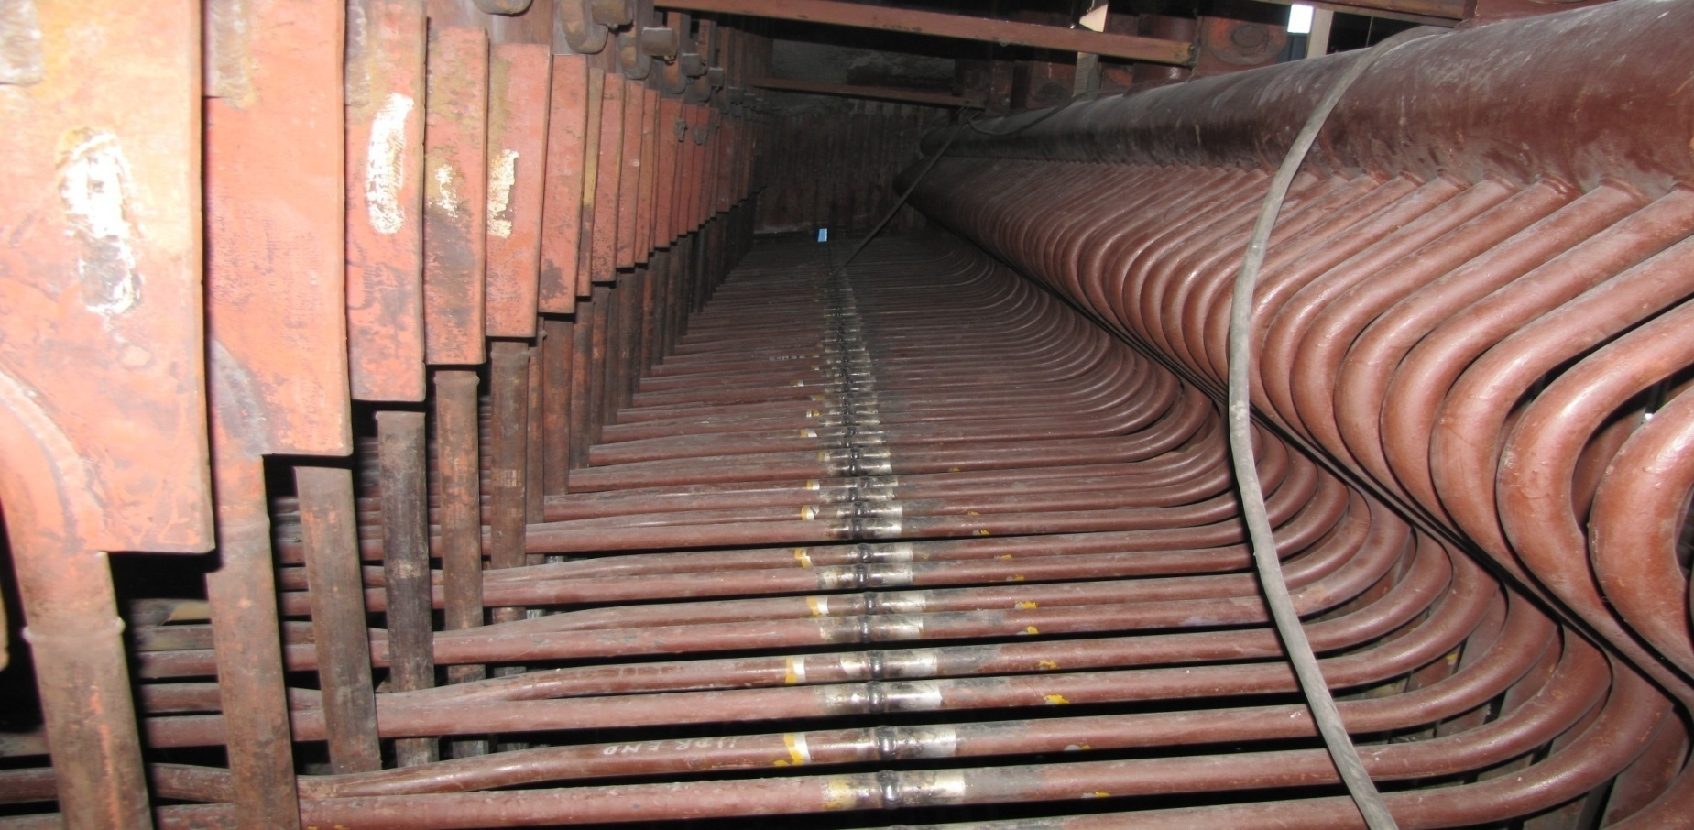
NLC India Limited
Barsingsar Thermal Power Station
Boiler Maintenance
BACK PASS – SCW ROOF TUBE WITH HEADER
Steam cooled wall roof tube
Steam cooled wall roof tube - Header

Slide 42
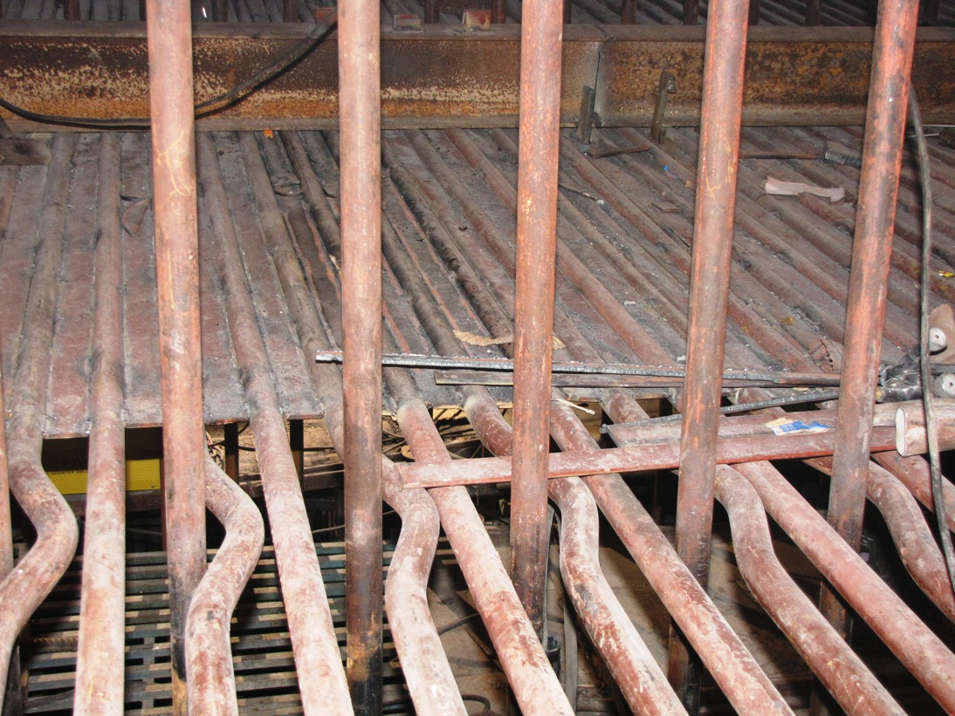
NLC India Limited
Barsingsar Thermal Power Station
Boiler Maintenance
AFTER LAYING OF FIN PLATE AT TOP ROOF

Slide 43
NLC India Limited
Barsingsar Thermal Power Station
Boiler Maintenance
BACK PASS – HANGER TUBE
Barsingsar Thermal Power Plant
Hanger tube puncture

Slide 44
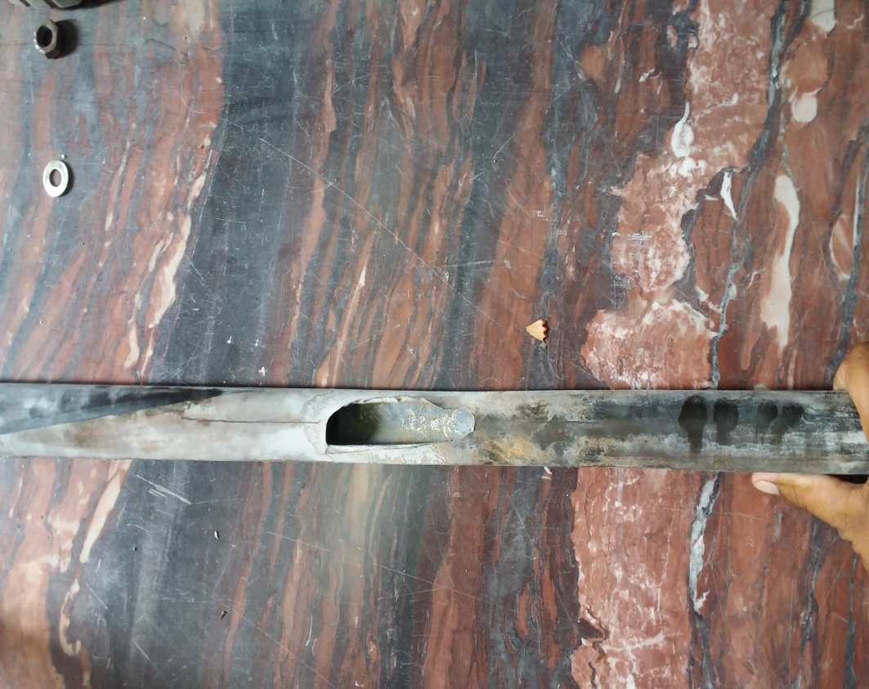
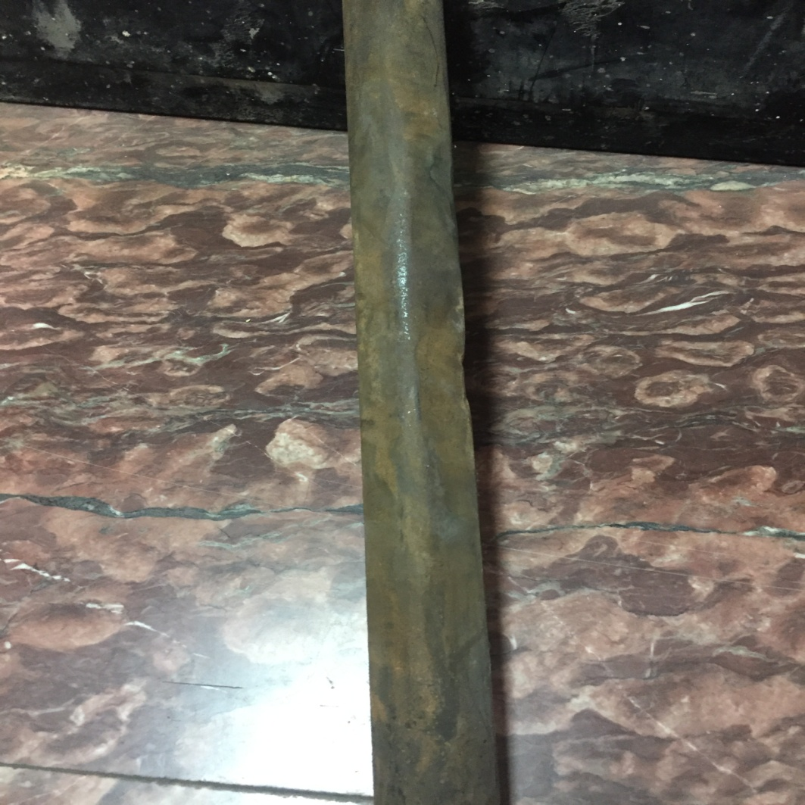
NLC India Limited
Barsingsar Thermal Power Station
Boiler Maintenance
BACK PASS – HANGER TUBE

Slide 45
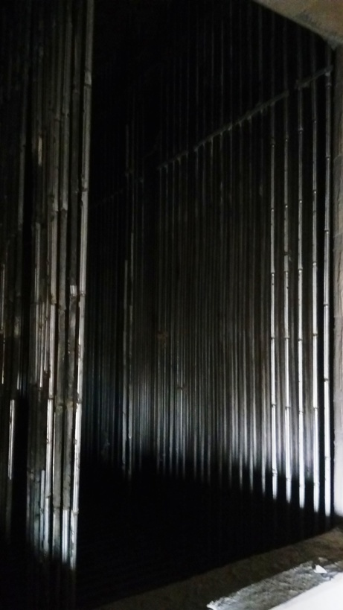
NLC India Limited
Barsingsar Thermal Power Station
Boiler Maintenance
BACKPASS HANGER TUBES AFTER HALF SLEEVE

Slide 46
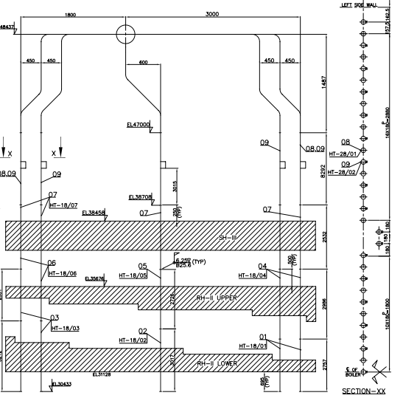
NLC India Limited
Barsingsar Thermal Power Station
Boiler Maintenance

Slide 47
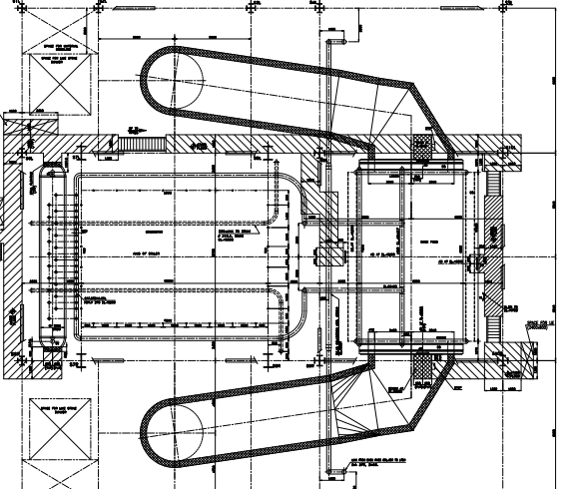
NLC India Limited
Barsingsar Thermal Power Station
Boiler Maintenance

Slide 48
NLC India Limited
Barsingsar Thermal Power Station
Boiler Maintenance
BACKPASS HANGER TUBES
The thickness survey of hanger tubes were carried out periodically when opportunity arises, the eroded tubes were cut and replaced.
In the Back pass hanger tubes is protected by half SS sleeves(thickness 3 mm) facing the flue gas flow direction were provided in the Back pass hanger tubes to protect the tubes from erosion

Slide 49
NLC India Limited
Barsingsar Thermal Power Station
Boiler Maintenance
BACKPASS HANGER TUBES WITH FULL SINGLE SLEEVE
To avoid such failure of half sleeves dislocation which lead to erosion of tubes and ultimately tube failures, it was decided to modify the existing half sleeves in rear row to full tube sleeves as preventive measure. This will completely eliminate the preventive maintenance works of dislocated sleeves correction during shutdowns, in addition to tube failures.
Accordingly, following materials were procured.
Seamless Tubes of OD 38mmx6.35mm thick of Material SA213T11.
2 .ERW SS Tubes of Size OD 45mmx2.5mmthick of Material SS304.
In phased manner, the thickness survey of hanger tubes were carried out periodically when opportunity aroused and the eroded tubes were cut & replaced.
In both the units, the new hanger tubes in rear row were fitted with new protective sleeves (Full tube sleeve) along the entire length of tubes, to prevent tube erosion failures.

Slide 50
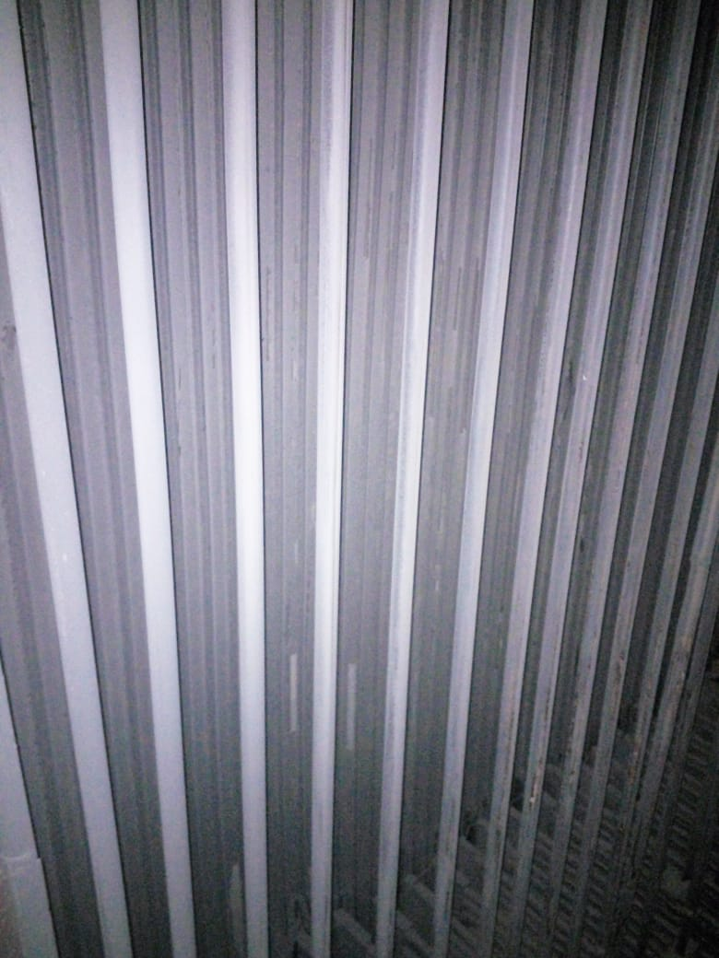
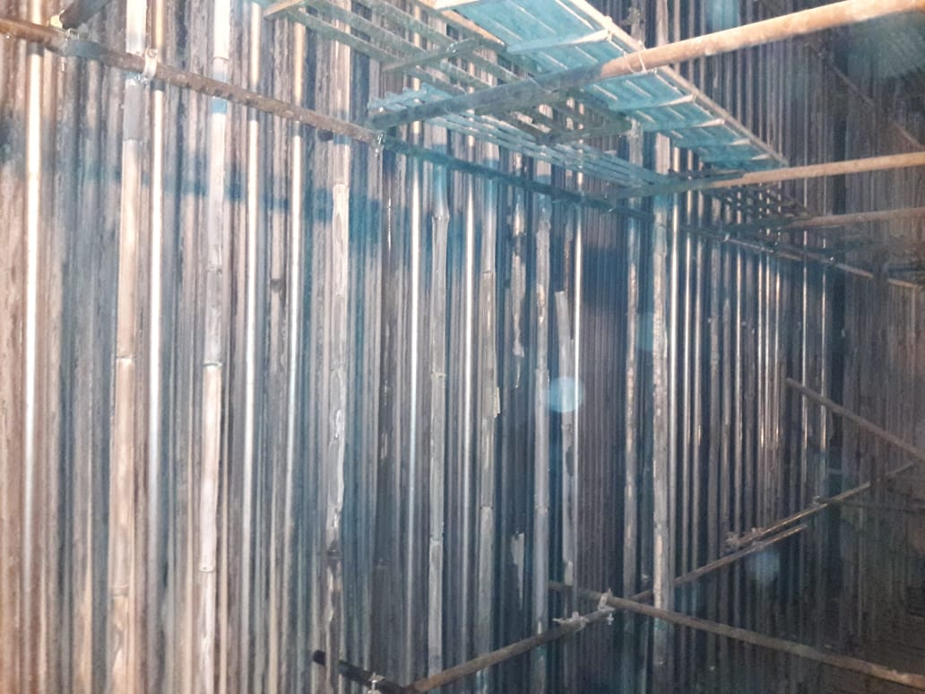
NLC India Limited
Barsingsar Thermal Power Station
Boiler Maintenance

Slide 51
NLC India Limited
Barsingsar Thermal Power Station
Boiler Maintenance
RESULT
After this modification, Unit stoppage due to Back pass steam cooled wall roof tubes and Back pass hanger tubes failure is completely eliminated for the past two years.

Slide 52
NLC India Limited
Barsingsar Thermal Power Station
Boiler Maintenance
Barsingsar Thermal Power Plant
Combustor water wall

Slide 53
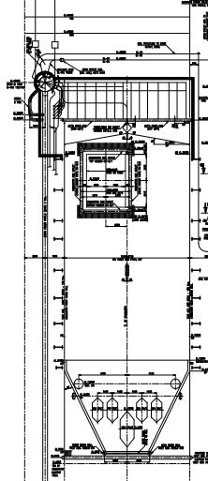
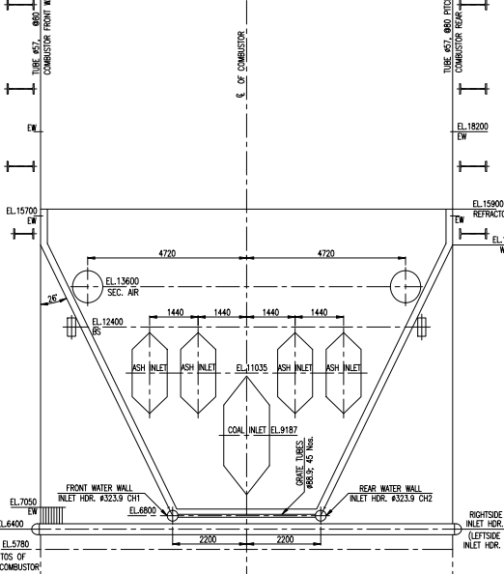
NLC India Limited
Barsingsar Thermal Power Station
Boiler Maintenance

Slide 54
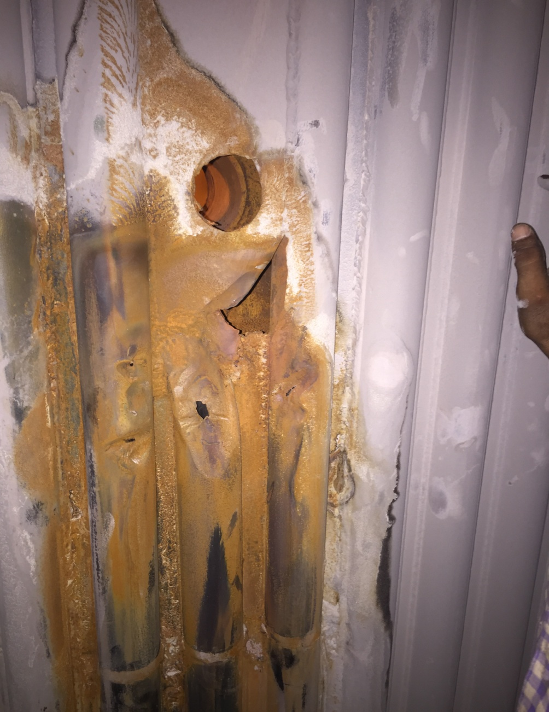
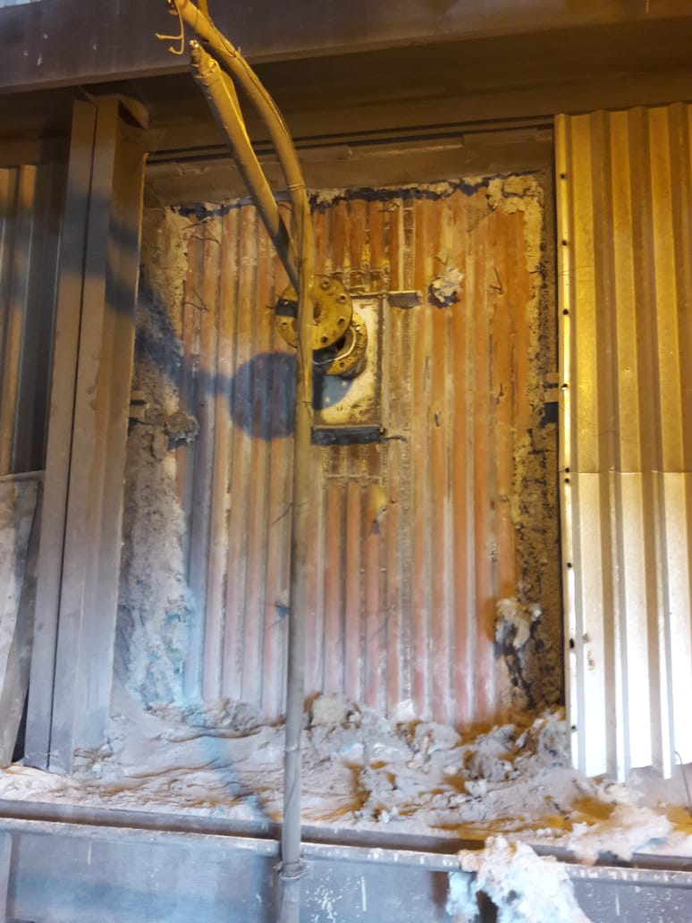
NLC India Limited
Barsingsar Thermal Power Station
Boiler Maintenance
U#1 31. 05.20 18

Slide 55
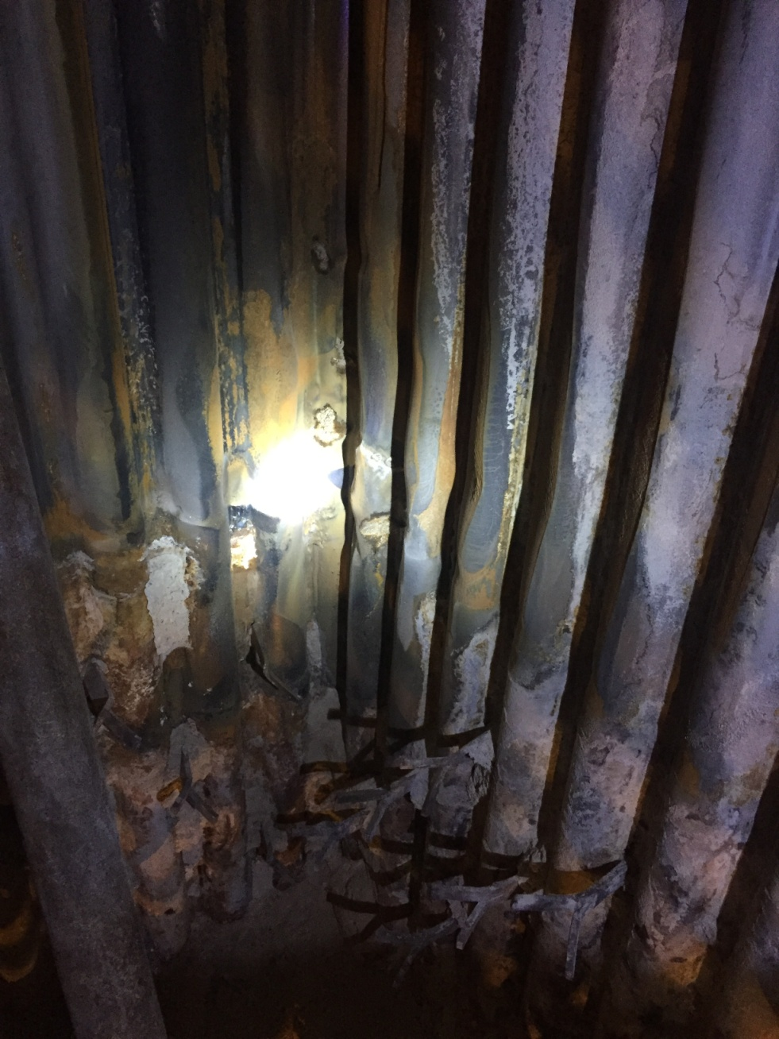
NLC India Limited
Barsingsar Thermal Power Station
Boiler Maintenance
U#1 29. 06 . 2018
puncture

Slide 56
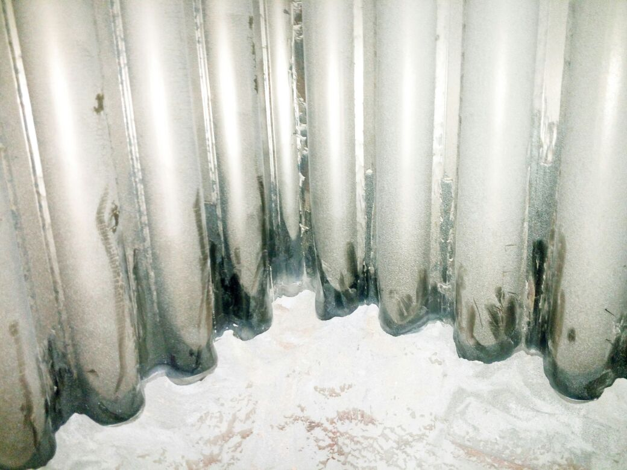
NLC India Limited
Barsingsar Thermal Power Station
Boiler Maintenance

Slide 57
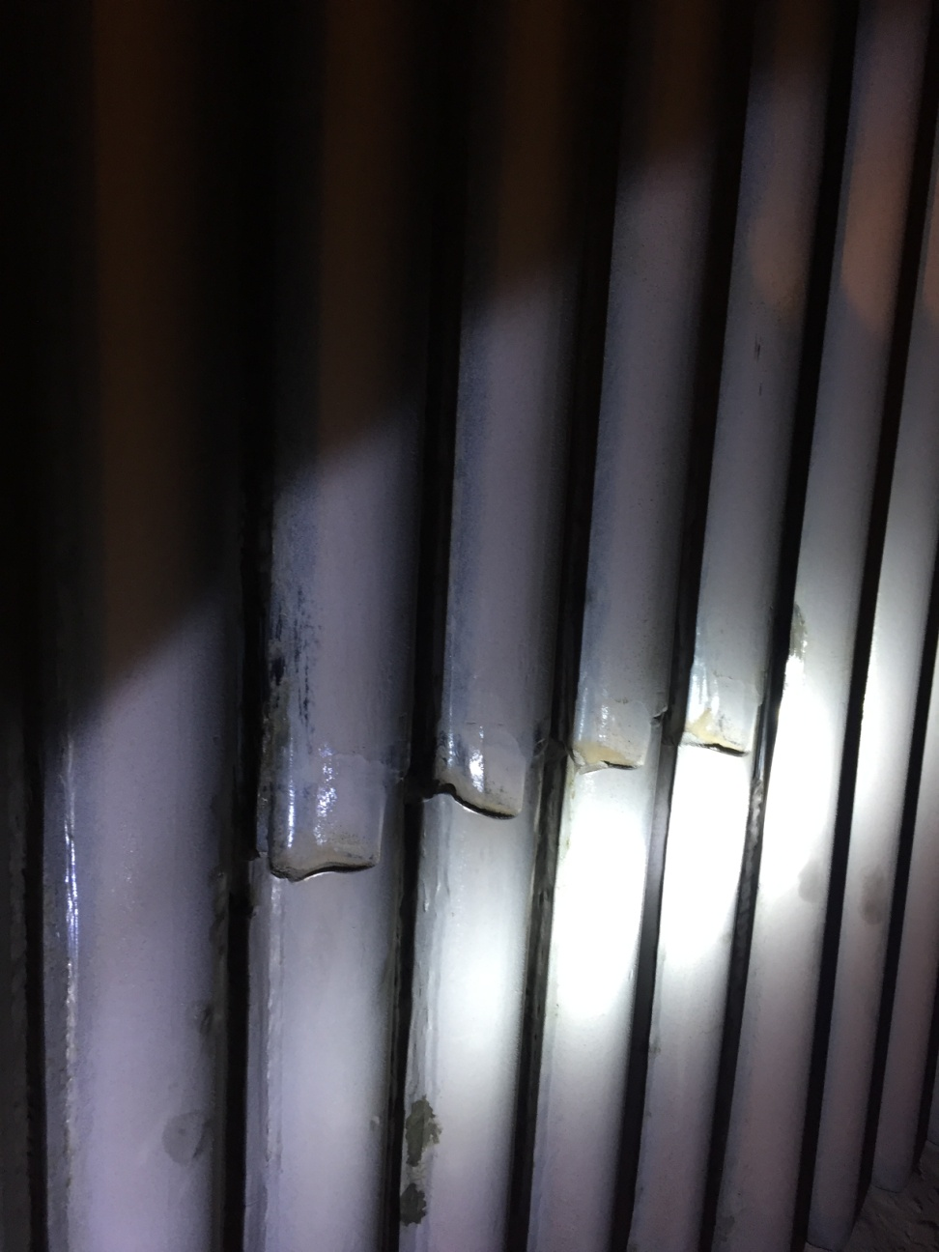
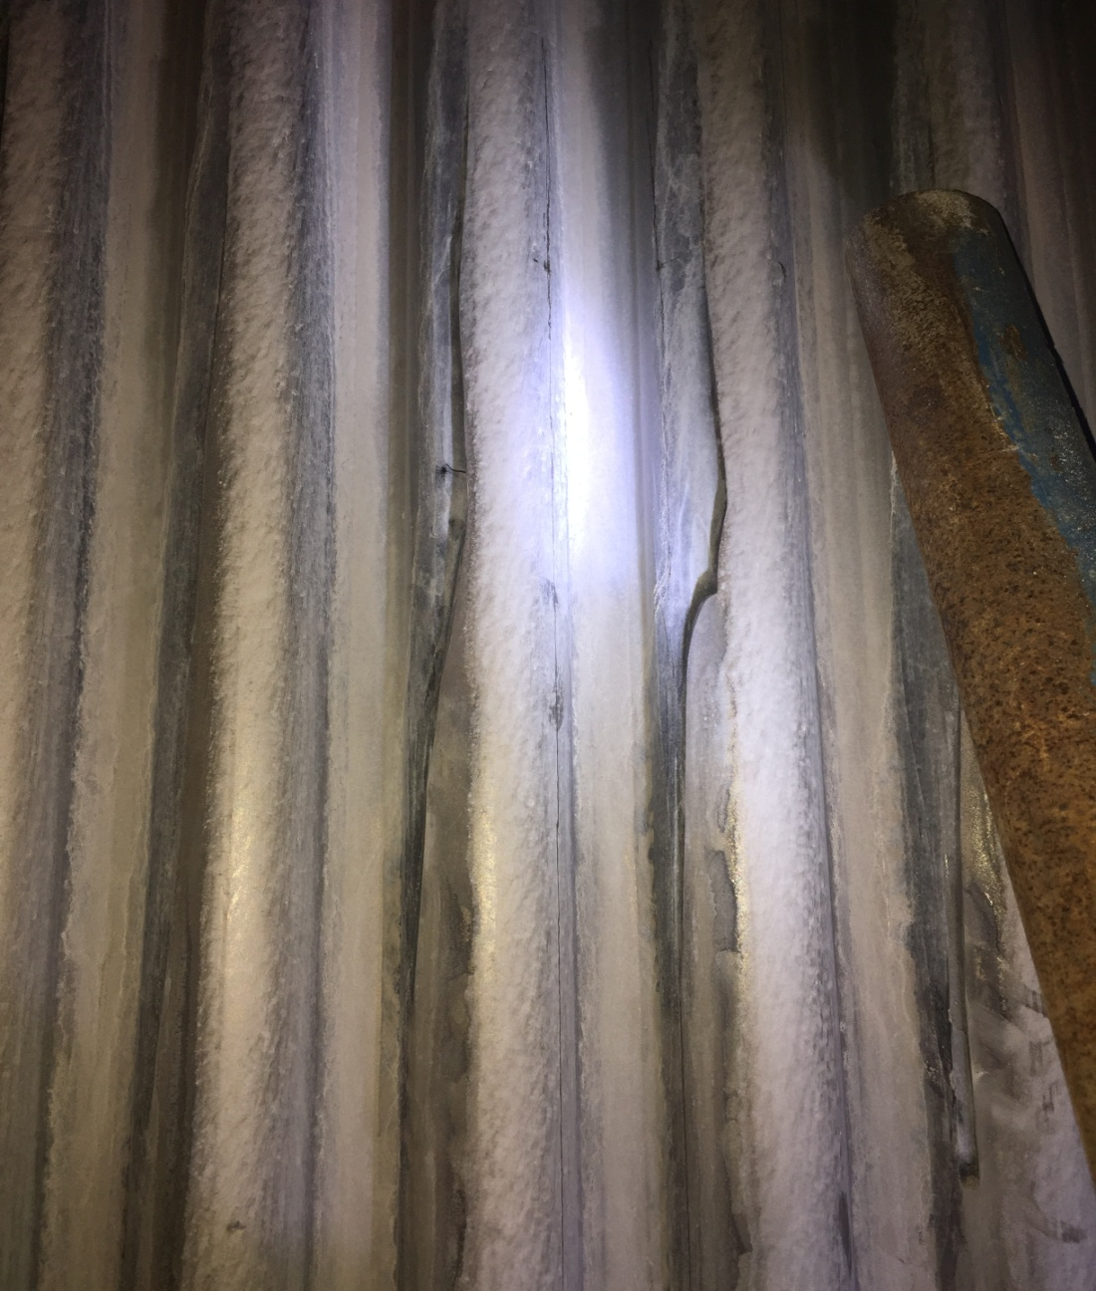
NLC India Limited
Barsingsar Thermal Power Station
Boiler Maintenance

Slide 58
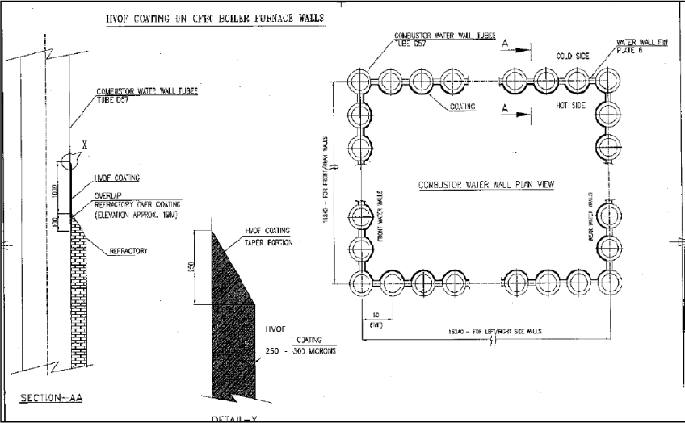
NLC India Limited
Barsingsar Thermal Power Station
Boiler Maintenance

Slide 59
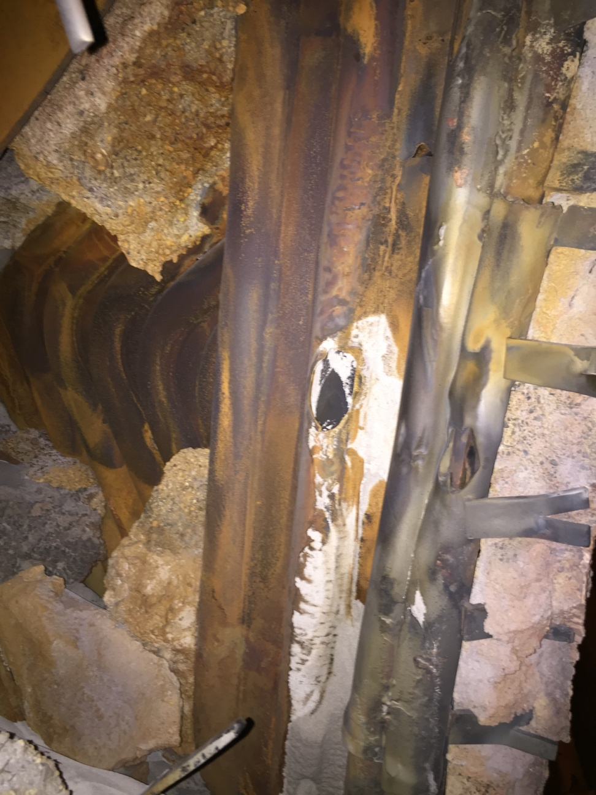
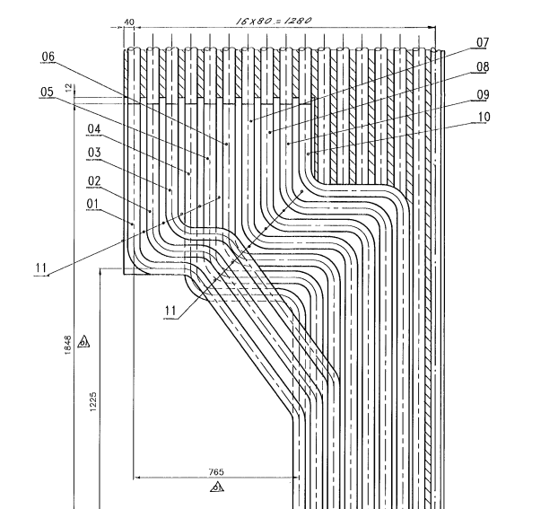
NLC India Limited
Barsingsar Thermal Power Station
Boiler Maintenance

Slide 60
NLC India Limited
Barsingsar Thermal Power Station
Boiler Maintenance
Barsingsar Thermal Power Plant
FBHE SIDE WALL AND PARTITION WALL

Slide 61
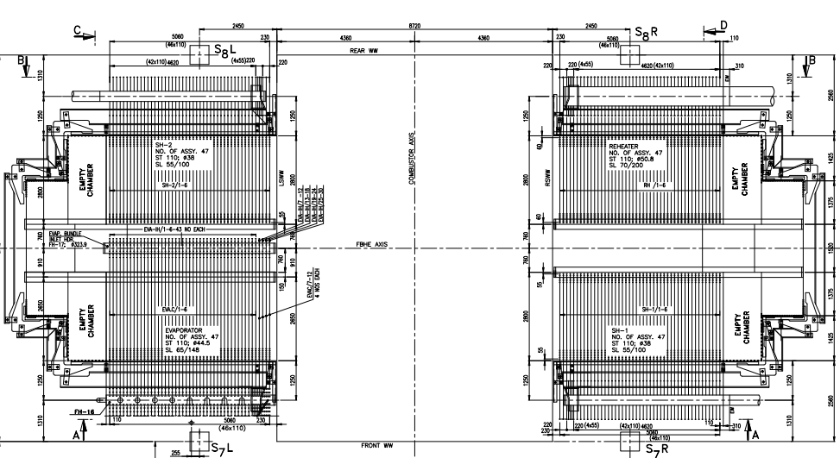
NLC India Limited
Barsingsar Thermal Power Station
Boiler Maintenance

Slide 62
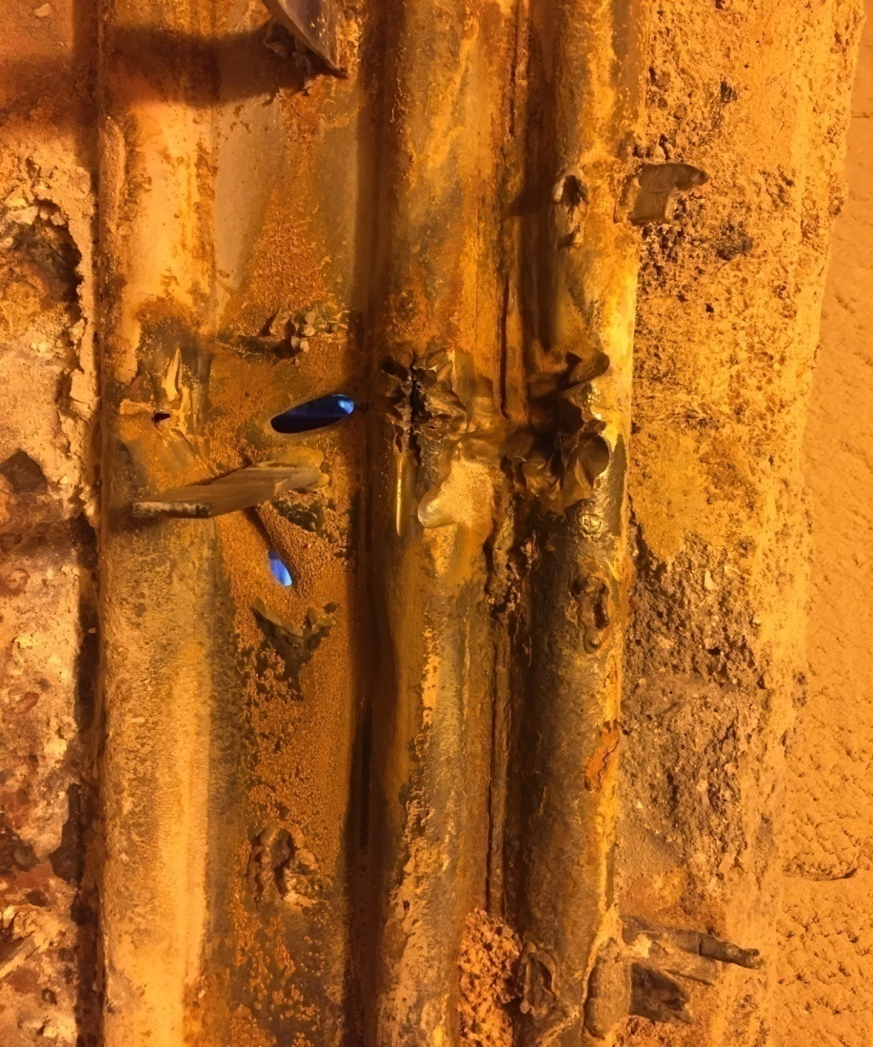
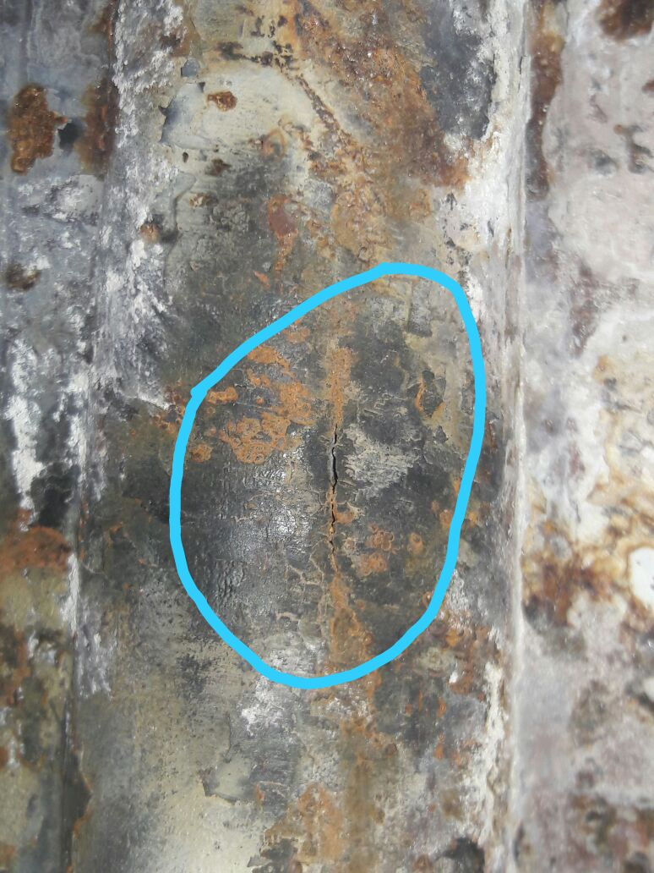
NLC India Limited
Barsingsar Thermal Power Station
Boiler Maintenance
FBHE-1 CORNER TUBE AND FBHE-3 SIDE WALL IN U#2 10.03.2018

Slide 63
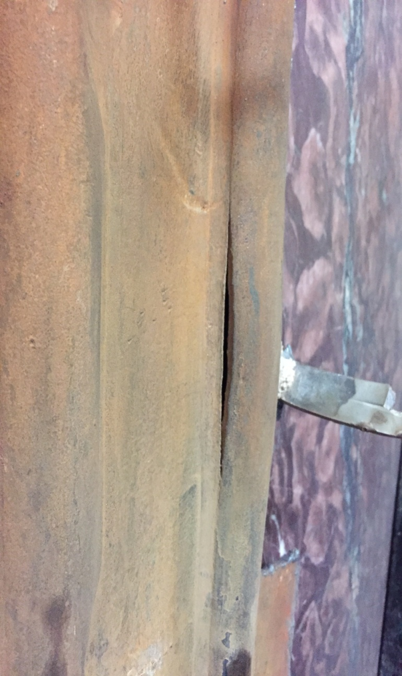
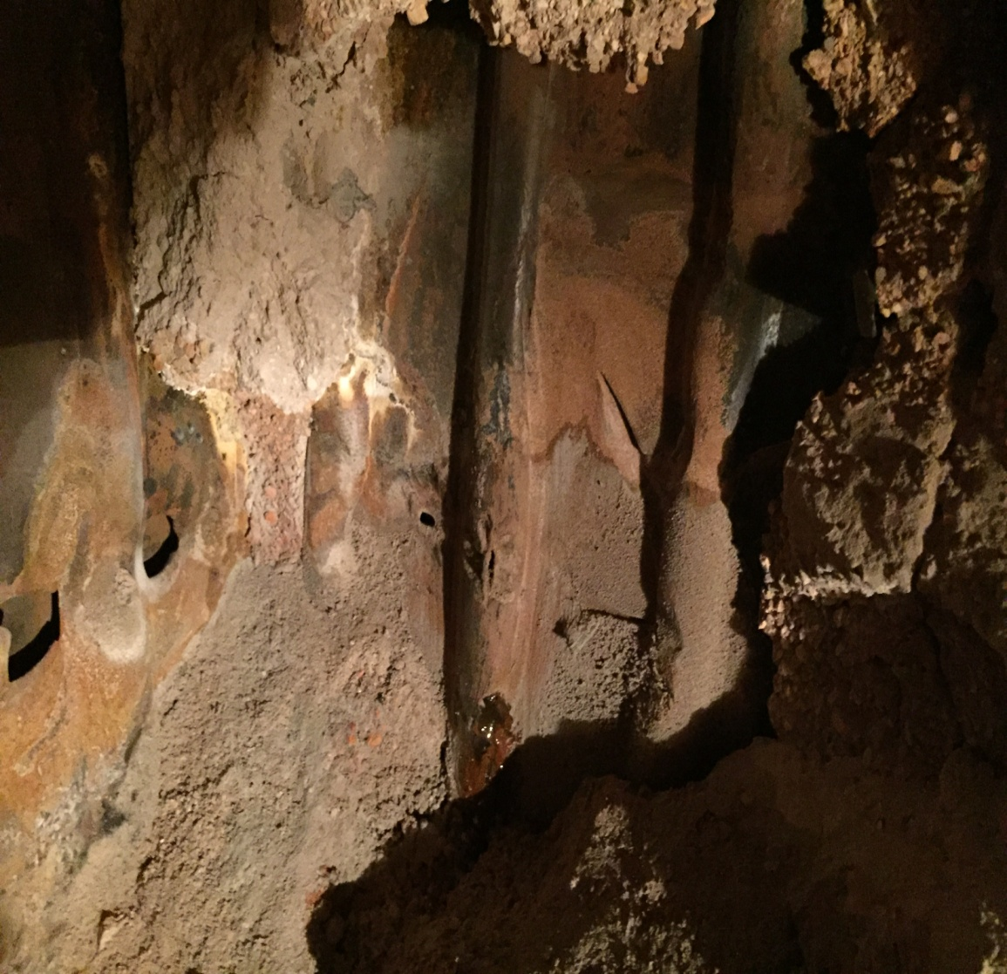
NLC India Limited
Barsingsar Thermal Power Station
Boiler Maintenance
U#2 20. 03. 2018
U#2 28. 07. 2018

Slide 64
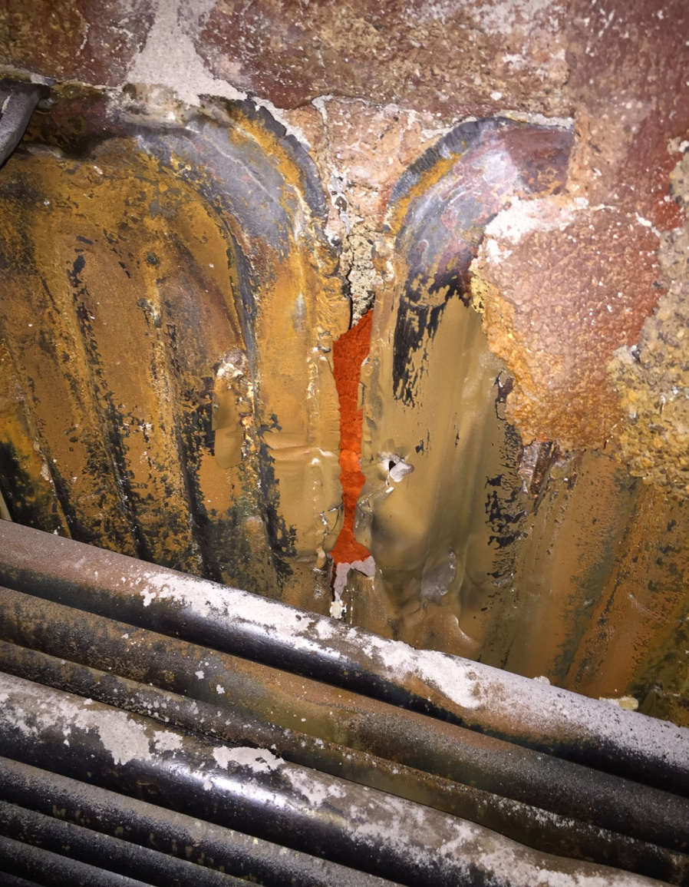
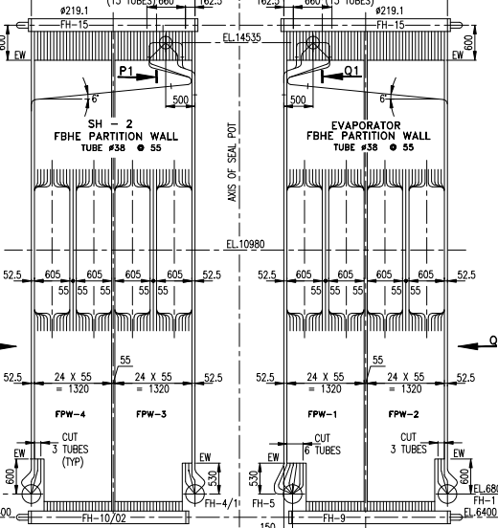
NLC India Limited
Barsingsar Thermal Power Station
Boiler Maintenance
U#1 FBHE-4 PARTITION WALL ON 15.09.2018

Slide 65
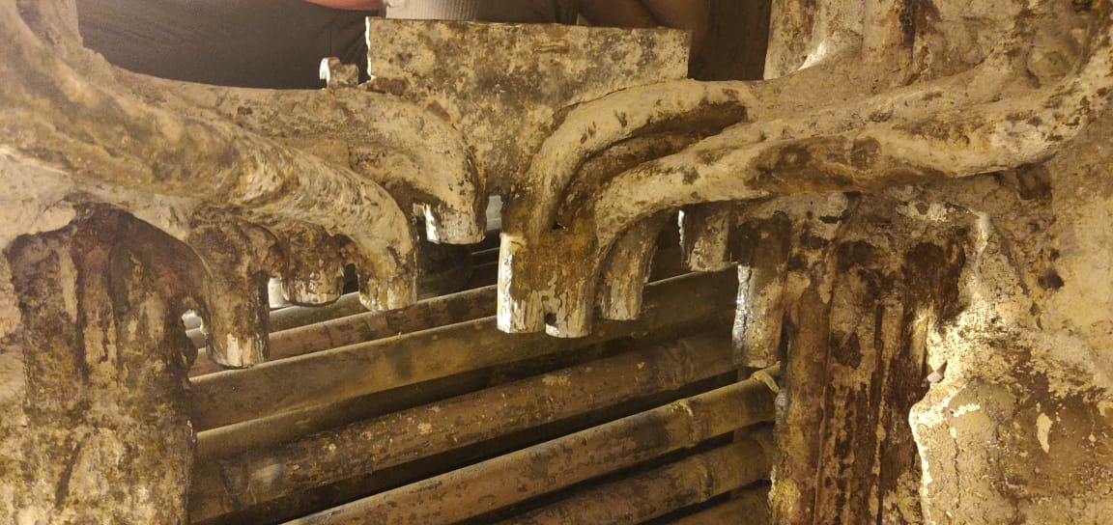
NLC India Limited
Barsingsar Thermal Power Station
Boiler Maintenance

Slide 66
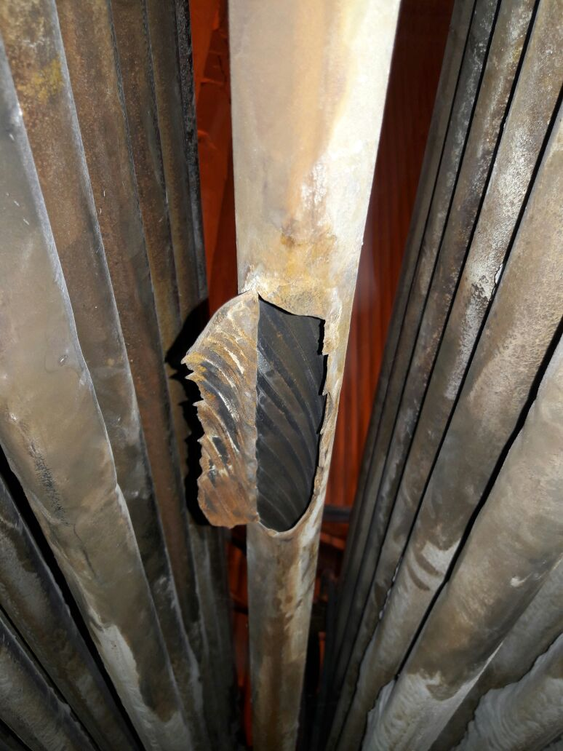
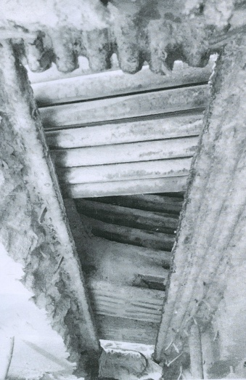
NLC India Limited
Barsingsar Thermal Power Station
Boiler Maintenance
U#1 18. 08. 20 17

Slide 67
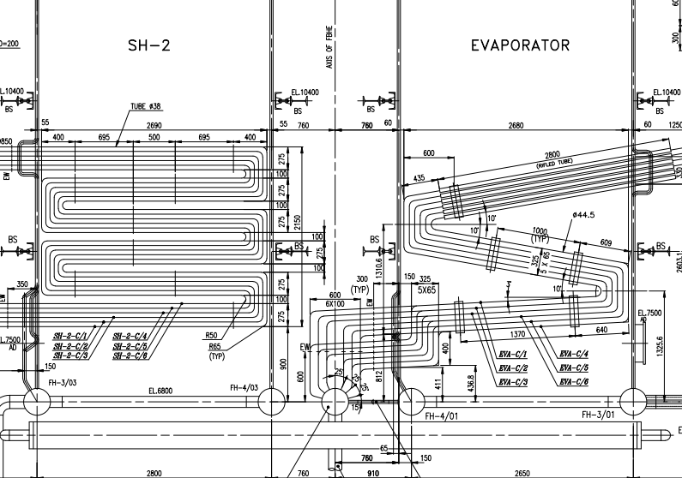
NLC India Limited
Barsingsar Thermal Power Station
Boiler Maintenance

Slide 68
NLC India Limited
Barsingsar Thermal Power Station
Boiler Maintenance
U#1 FBHE-2 SH 25.05.2017

Slide 69
NLC India Limited
Barsingsar Thermal Power Station
Boiler Maintenance
THANK YOU

